Slide 1




Introduction to BizTalk Server 2010
Universidade Portucalense
DevScope
Universidade Portucalense
19-11-2012
Sandro Pereira

Slide 2



Sandro Pereira
Senior Software Developer at DevScope - sandro.pereira@devscope.net
Microsoft Integration MVP since 2011
Writer of numerous articles for Portuguese eMagazine “Programar”
Autor “Sandro Pereira BizTalk Blog” http://sandroaspbiztalkblog.wordpress.com
Member of “BizTalkAdminsblogging.com” and “BizTalk Brasil” community
Member NetPonto community
BizTalk Forums Moderator
TechNet Wiki author (Wiki Ninja)
TechNet Gallery, Code Gallery and CodePlex contributor
Public speaker
Technical Reviewer PACKT Publishing
BizTalk Server 2010 Cookbook (April 2012)
Microsoft BizTalk 2010 Administration Essentials (expected November 2012)

Slide 3
Agenda
Introduction to DevScope
Enterprise Application Integration Challenges
Introduction to BizTalk Server 2010
What is? What does BizTalk do? And what type of problems it solves?
Major features
Demos
Job Market

Slide 4
DevScope
who we are

Slide 5
DevScope's philosophy
Team of high experience professionals with specialized know-how
Collaboration/SharePoint,
Business Intelligence,
CRM
System Integration (BizTalk)
Focus on innovation
State of art technology
Where we operate… World Wide

Slide 6


what we are
consulting
software
saas

Slide 7






consulting
bigdata
biz intelligence
integration
cloud
azure
mobile
portals
crm

Slide 8






software
smartdashboards
cloud.facilt.us
smartpaste

Slide 9

software as a service
24/7
operations
>_
federation
automation
monitoring

Slide 10

chronology
Grand Prix Awards: Europe’s Best Intranet (Amorim Imobiliária)
Office “14” Technology Adoption Program
European Enterprise Awards (APDL Portal Executivo)
Microsoft Certified Partner
Gold Certified Partner
BizTalk MVP (Sandro Pereira)
Azure Circle Partner
PME Líder

Slide 11





























References

Slide 12
Enterprise Application Integration Challenges
Microsoft Integration Story

Slide 13



Current Integration Challenges
Inconsistent
Information
Inefficient
Processes
Incompatible
Systems
Notes:
Enterprise Connectivity and Processing
Event Driven Architecture
Data flow and Data warehouse ETL
Master Data Management and Data Quality
High throughput and low latency
Cloud and inter-enterprise Connectivity
Data Access from a Unified User Interface
Burst scenarios & Sometimes connected clients/scenarios
Integration as a service

Slide 14











Evolving Integration Needs
2010 Cloud
2000 SOA
1990 Web
1980 Client-Server
1970 Mainframe

Slide 15









The Integration Challenge – The need for communication
Supplier
Company A
FTP
EDI
Customer
XML
MQSeries
HTTP
TCP/IP
X12-997 PO
Manufacturer
CRM
X12-850 PO
SMTP
SAP
Notes:
An organization may follow a software with different configuration for a process and another software with entirely different configuration to take care of another process
Both processes may depend on each other’s data
For example a company’s attendance system need to be connected with payroll system
Or a purchase order need to be communicated to invoice generating system

Slide 16
Connecting Application is Not Enough Point-to-Point Integration Inhibits Agility
Java Appl.
Service
.Net Appl.
Service
Point-to-Point
Complex Interface
Redundant Logic
Doesn’t Scale
Lacks Visibility
Business Impact
Delays Response to changing business needs
SAP
Service
Oracle
Service
JD Edwards
Service
MS CRM
Service
CICS Service
AS/400
Service

Slide 17
Application Integration
High costs and effort because application data is
Proprietary
Incompatible
Undocumented legacy data
Different data formats

Slide 18
Product and frameworks
Microsoft BizTalk Server 2010
Microsoft Stream Insight
SQL Server Integration Services
SQL Server Master Data Services
Windows Server AppFabric
Windows Azure Service Bus Relayed Messaging
SharePoint Business Connectivity Services
Windows Azure Service Bus Brokered Messaging
Windows Azure Service Bus EAI & EDI

Slide 19
Microsoft BizTalk Server 2010
Introduction

Slide 20



















What is BizTalk Server?
Empresa
Fabricante
Revendedor
Distribuidor
Logística
Logística
Escritórios
Fornecedor
Fornecedor
Notes:
Para começar tenho de perguntar aqui quem sabe o que é o BizTalk Server?
Podíamos começar por definir o BizTalk, de uma forma simples, como um router/broker de mensagens
Para fazer uma analogia com o mundo real, como uma plataforma logística de troca de mercadorias.
As matérias primas entram nas empresas, são armazenadas, processadas, transformadas e enviadas aos clientes.
E da mesma forma as mensagens electrónicas são…

Slide 21

What is BizTalk Server?
EAI / BPM
Notes:
Recebidas, validadas, arquivadas, transformadas e enviadas para outros sistemas.
Nestes processos, o problema é a quantidade de novas ligações que é preciso manter a funcionar durante muitos anos.
Ao mesmo tempo novos processos são adicionados e os existentes vão sofrendo pequenas melhorias, tudo sem perder o rasto ao que está a acontecer em produtivo.
O BizTalk ajuda-nos a resolver muitos destes problemas, resolvendo automaticamente questões como a persistência, tracking de todas as mensagens, tratamento e recuperação de erros, suporte a transacções, encriptação e assinaturas digitais, os processos asyncronos de workflow, etc…
Para além disto tudo, esta plataforma já tem mais de 10 anos (Microsoft BizTalk Server 2010 é a sétima versão do produto) e portanto é uma plataforma madura e com muitos componentes 3rd-Party (mais de 25 adaptadores multiplataforma) para ligação a sistemas como o SAP, Oracle, Siebel, SQL, etc…
Gostava de frisar aqui um ponto: um dos desafios que se colocam nestes cenários é exactamente a transformação de documentos…

Slide 22



Microsoft BizTalk Server 2010
“Microsoft BizTalk Server is used to simplify and automate the exchange of information between publishers and subscribers, to orchestrate business processes and to supply insight into processes”
Company A
BizTalk Server
Application
Application
Application
Internet
Company B
Notes:
BizTalk Server is Microsoft’s Integration and connectivity server solution
Connects disparate systems together
Communication among systems are established through messages
All messages inside BizTalk are XML data
Since XML can be interpreted in any system, BizTalk helps in connectivity
Includes over 25 multi-platform adapters and a robust messaging infrastructure
Provides strong durable messaging, a rules engine, EDI connectivity, Business Activity Monitoring (BAM), RFID capabilities and IBM Host/Mainframe connectivity

Slide 23
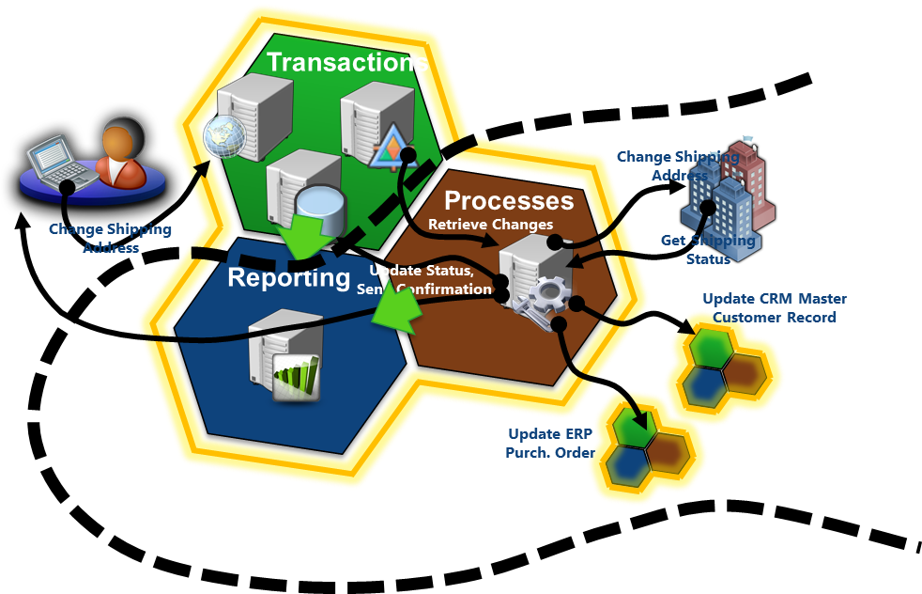
What does BizTalk do?
BizTalk Does This…
Solve integration challenges between systems, events, devices
Automate integration processes
Simplify building and managing these processes
Capture, analyze and present process data
Notes:
Allows organizations to more easily connect disparate systems
Includes over 25 multi-platform adapters and a robust messaging infrastructure
Provides strong durable messaging, a rules engine, EDI connectivity, Business Activity Monitoring (BAM), RFID capabilities and IBM Host/Mainframe connectivity

Slide 24
What Problems Does BizTalk Server 2010 Solve?
Common complaints:
Disparate applications
Programming overruns
Time-consuming deployment
Dissimilar reports
Modification difficulties
Lack of set procedures
Limited tracking
Changing partners
Notes:
Common Complaints
As empresas muitas vezes adquirem múltiplos sistemas e/ou aplicações de diferentes fornecedores para atender as necessidades de seus negócios. Isso resulta em uma variedade de aplicações que correm em plataformas dedicadas e que não foram projectados para trabalhar em conjunto. Isso porque cada aplicação geralmente é projectado de forma isolada para cumprir um propósito específico, como estoques, recursos humanos ou gestão de relacionamento com clientes (CRM).
Consider the following common integration complaints:
Disparate applications. “It is too difficult to integrate dissimilar applications within my company.”
Programming overruns. “It takes too long to develop integrated applications for my company’s enterprise resource plan with our existing development tools.”
Time-consuming deployment. “Deploying a business process to integrate with my trading partner’s system takes practically as long as developing the process in the first place.”
Dissimilar reports. “There is no way to generate integrated, timely reports from my various applications, because the data is stored in so many places.”
Modification difficulties. “Once my internal applications are integrated, changing them is arduous and expensive.”
Lack of set procedures. “My company does not have a consistent method for implementing our critical business processes.”
Limited tracking. “I have no way of extracting usable, real-time data from a running business process.”
Changing partners. “If another business offers me a better deal, it is too difficult to take advantage of it because of all of the IT infrastructure changes that it would require.”

Slide 25
Why BizTalk?
One single tool and infra-structure for system integration
Simplify and automate interoperability to reduce costs and errors
Automate your business interactions with partners
Gain critical insights on business processes and performance
Solutions can be developed really fast with BizTalk Server. Effort spent will be less.
Updates can be handled in an easy way and maintenance will be easy
Negative scenarios can be handled easily with BizTalk Server
Notes:
If some Service is down, we can set Retry Mechanism, Alternate Transport Mechanism. It even supports service windows. We can take advantage of enlist and stop features and
prevent losing even a single Message

Slide 26
Who uses BizTalk Server?
10000+
10,000+ Global Customers benefit from using BizTalk Server
23
23 of 27 EU governments use BizTalk Server to provide government services
81%
81% of the Global 100 are running BizTalk Server
6
6 of the 8 largest U.S. Pharmaceutical Companies use Microsoft BizTalk Server
4
4 of the 5 largest U.S. Electronics Parts Manufacturers use Microsoft BizTalk Server
9 of 10
9 of 10
9 of 10 largest U.S. Telecommunications Companies use BizTalk Server
5
9 of the 10 largest Aerospace and Defense Companies in the U.S. run BizTalk Server
5 of the 8 largest U.S. Chemical Companies run Microsoft BizTalk Server
4
4 of the 5 largest Railroads in the U.S. run Microsoft BizTalk Server
9 of the 10 largest Insurance Companies in the World run Microsoft BizTalk Server

Slide 27
Evolution of BizTalk Server
BizTalk Server
2010
CONTINUOUS INNOVATION EVERY 2-3 YEARS
BizTalk Server
2009
BizTalk Server
2006 R2
Workflow Integration
ESB 2.1
SharePoint 2010 BCS
Data Mapper
TPM
Secure FTP
Updated Swift and HIPAA
SQL Server 2008 R2
Windows Server 2008 R2
HIS 2010
BizTalk Server
2006
ALM Support
B2B Enhancements
RFID Mobile
Adapter Pack 2.0
ESB 2.0 Toolkit
BAM+
Hyper-V Support
HIS 2009
BAHS 2.0
BizTalk Server
2004
SOA/ESB
EDI/AS2
RFID
WCF
Adapter Pack
Adapter SDK
HIS 2006
BAHS
BizTalk Server
2002
Simple configuration
Adapters in box
Runtime+
BAM+
BizTalk Server
2000
VS + .NET
Messaging + Orchestration
BRE
Routing
BAM
Scale-out
Deployment Tools
XSD
EAI (partner adapters)
Vertical B2B
Messaging
XML tools
XLang
500 Customers
2,000 Customers
4,000 Customers
7,000 Customers
8,500 Customers
10,500 Customers
12,000 Customers

Slide 28
BizTalk Server Roadmap: today Committed to innovation in Integration
BizTalk Server 2010
- Platform Support
- Productivity
improvements
- B2B scenarios made
easy
BizTalk Server 2013
- Integration with Cloud Services:
- RESTful services
- New Adapters and many improvements in existing adapters
BizTalk PaaS
- EAI Capabilities in the Cloud
- EDI Capabilities in the Cloud
- Build Hybrid Applications
~12 years, 12,000+ customers
8th release
Regular updates 18-24 months
Available now
2013
Future

Slide 29
BizTalk Server 2010 Editions
Edition | Description
Enterprise | For large organizations, trading hubs, and marketplaces Includes all application and technology adapters Unlimited internal applications Multiple processors and clustered deployments
Standard | For small to medium-sized organizations Includes all application and technology adapters Up to five internal applications Up to two processors
Branch | For remote locations of an organization Includes all technology adapters Single internal application Up to two processors
Developer | For development and testing uses Free license with same capabilities as Enterprise Edition
Notes:
Microsoft BizTalk Server 2010 is available in five editions designed to meet the needs of organizations of different sizes and needs:
Enterprise Edition. BizTalk Server 2010 Enterprise Edition is targeted to large organizations and trading hubs as well as digital marketplaces. Enterprise Edition offers the complete set of BizTalk Server 2010 features. It supports an unlimited number of internal applications running on multiple processors, and it supports clustered deployments. Microsoft also offers a specialized edition of BizTalk Server 2010 named the RFID Enterprise Edition that offers only RFID capability for integration of remote RFID sensors.
Standard Edition. BizTalk Server 2010 Standard Edition is designed for small and medium-sized organizations. It offers the same set of features as BizTalk Server 2010 Enterprise Edition, but the number of internal applications is limited to five. This is a decrease of 5 internal applications, but there is no longer a limit to the number of trading partners. Standard Edition will run on 2 CPUs on a single server.
Branch Edition. BizTalk Server 2010 Branch Edition is a new licensing option. Branch Edition is designed for intra-enterprise hub and spoke scenarios. You can use Branch Edition to integrate 1 internal application with a BizTalk Server “hub” that coordinates/aggregates events across multiple Branch Editions. It is a subset of BizTalk Server 2010 functionality that includes the technology adapters, RFID, mobile support and Host Integration Server. Branch Edition does not include the application adapters, the BizTalk Adapter Pack or any of the BizTalk accelerators. Branch Edition is limited to 2 CPUs on a single server with a single message box.
Developer Edition. BizTalk Server 2010 Developer Edition is available as a free download from the Microsoft web-site. It provides the same set of features as Enterprise Edition, but it is not licensed for production use. Developers can use this edition of BizTalk Server 2010 in a development environment for application development and testing, and for deploying applications to a full production environment.

Slide 30
Key concepts
BizTalk Server 2010 Capabilities and Runtime Architecture

Slide 31
BizTalk Server 2010 Capabilities
Management and Operations
Business Rule Framework
Business to Business Integration
Business Activity Monitoring
Orchestration
AppFabric Connect Integration
Messaging
Tools
RFID Platform
Notes:
Messaging: Inbound, Outbound, Durable Messaging, Message Security, Message Assembly/Disassembly, Pluggable Adapters, Message Security, Message Assembly/Disassembly, Pluggable Adapters, Enterprise Single Sign-On, Service Enablement
• Web Services based messaging (WS* standards)Windows® Communication Foundation (WCF) Adapters • WCF-BasicHttp • WCF-WsHttp • WCF-NetTcp • WCF-NetMsmq
Orchestration: Flow Control, Port Bindings, Scopes, Design Patterns
• Asynchronous Response Correlation • Aggregator • Composed Message Processor • Dynamic Router • Parallel Convoy • Scatter and Gather • Sequential Convoy • Splitter
Business to Business Integration: Trading Partner Management, EDI Support, AS2 Support, Industry Accelerators • SWIFT • HL7 • RosettaNet
Business Rule Framework: Business Rule Engine, Business Rule Authoring
Business Activity Monitoring: Observation Model Design, Event Observation Engine, Reporting
Management & Operations: Application Management, Tracking Configuration & Reporting, Host Management, Application Deployment, Best Practices Analysis, MOM Monitoring, Data Management
AppFabric Connect Integration: Line of Business Applications (LOB) activities (Consume LOB operations as Windows Workflow Foundation (WF) activities), Mapper Activity (Transformation as a WF activity)
RFID Platform
Tools
• Schema Editor
• Flat File Schema Wizard
• Mapper
• Pipeline Designer
• Orchestration Designer
• WCF Service Publishing Wizard
• Administration Console
• MOM Management Pack
• Best Practices Analyzer
• Business Rule Composer
• Policy Deployment Wizard
• Orchestration Designer for Business Analysts
• Observation Model Designer
• Tracking Profile Editor
• BAM Portal
• BAM Manager
• EDI User Friendly Schema Viewer
• EDI Document Instance Generation/Validation
• Trading Partner Portal
• RFID Manager
• RFID Tray
• RFID Event Simulator
• RFID Client Console

Slide 32









BizTalk Server 2010 Integration Scenario
RFI
Filter Tags
Policy
Read Shipment RFID Tags
5
Microsoft BizTalk Server 2010
Inventory Application
Messaging
Manage and
Operate
Re-stock Orders
Orchestration
1
EDI
IT Pros and Developers
4
Design and Implement
Messaging
Assign Supplier
Policy
Up-to-date KPIs in BAM
Suppliers Application
Messaging
2
3
Business
Users
Enterprise Resource Planning (ERP) Application
Notes:
Neste cenário, um aplicativo de inventário, talvez a correr num mainframe, determina que o stock de um item é baixa e emite um pedido para pedir mais desse item. Ocorrem as seguintes etapas:
The request is sent to a BizTalk Server 2010 application
The BizTalk application requests a purchase order (PO) from the organization’s Enterprise Resource Planning (ERP) application.
The ERP application, which might be running on a UNIX system, sends back the requested PO.
The BizTalk application informs a fulfillment application, built on the Microsoft .NET Framework, that the item should be ordered
Neste exemplo, cada aplicação comunica por meio de um protocolo diferente, utilizando os formatos de mensagens específicas de cada aplicação. Isto significa que o mecanismo de mensagens do BizTalk deve ser capaz de se comunicar com cada aplicativo no seu protocolo de comunicação e formato nativo e também converter as mensagens para o protocolo e formato exigido pelos demais sistemas.

Slide 33


BizTalk Server 2010 Runtime Architecture
XML EDI or Flat File
XML EDI or Flat File
Receive Port
Orchestration
Send Port
Receive Adapter
Receive Location
Send Adapter
Receive Pipeline
Send Pipeline
Mapping
Mapping
FROM: Contoso (Flat file format)
TO: NWTraders (Flat file format)
MessageBox
TO: Fabrikam (XML format)
FROM: Fabrikam (XML format)
Notes:
The two main services in BizTalk Server 2010, the messaging engine and the orchestration engine
O objetivo do BizTalk é processar mensagens. Toda a comunicação dentro e entre um servidor de BizTalk são baseados na troca de mensagens. Por esse motivo, o mecanismo de mensagens é essencial para todas as operações do BizTalk.
The BizTalk messaging engine performs the following tasks:
Receives inbound messages
Parses inbound documents to identify their specific formats
Extracts key identifiers and identifies applicable routing rules
Delivers documents to their respective destinations including ports or orchestrations
Tracks documents
Message database
The MessageBox database is a Microsoft SQL Server™ database that is used by BizTalk to store and route messages to orchestrations and send ports. When a message arrives in the MessageBox database, the metadata associated with the message is matched and evaluated to determine the services that subscribe to messages of this type.
Publish-Subscribe Model
BizTalk Server implements a publish-subscribe model for the routing of messages. In the publish-subscribe model, message providers (publishers) submit messages to a central store (the MessageBox), where subscribers (send ports and orchestrations) can subscribe to specific messages. After a message of interest is received by the MessageBox, it is sent to all subscribers

Slide 34
The BizTalk Server Development Environment
Lesson 3

Slide 35


The BizTalk Server Development Environment
System Requirements
Minimum hardware requirements: 1-GHz Pentium-compatible CPU; 2 GB of RAM; 10 GB of available hard disk space
Recommended hardware: 2-GHz or higher Pentium-compatible CPU; 3 GB or more of RAM; 60 GB or more of available hard disk space
SO: Windows Server 2008 R2 or Windows Server 2008 or Windows 7 or Windows Vista SP2
Software Requirements
Minimum Developer Installation: .NET Framework 3.5 with SP1; .NET Framework 4; SQL Server 2008 R2 or SQL Server 2008 with SP1; Visual Studio 2010 with C# Installed; BizTalk Server 2010 Developer Edition

Slide 36


Project Templates
BT
BT
Empty BizTalk Server Project
BizTalk Server BPEL Import
Contain files, programs, tools for creating BizTalk applications
Specify the structure, constraints, and content of the items in a project
Notes:
Empty BizTalk Server Project. Use the Empty BizTalk Server Project template when you want to create a new application that runs on BizTalk Server 2010. This is the most common BizTalk project type.
BizTalk Server BPEL Import Project. Use the BizTalk Server Business Process Execution Language (BPEL) Import Project template to launch the BPEL Import Wizard. This wizard will guide you through the necessary steps to import BPEL, WSDL, and XSD files into a BizTalk Project.

Slide 37

Tools for Developers
Define Schemas
Transform Data
Customer
Header
Order
Name
BizTalk Editor
PO
PO
Title
Visual Studio 2010
Record
Item
Status
Date
PO
Header
Item
Detail
Status
Field1
PO
FieldA
ItemID
Field2
Status
BizTalk Mapper
Field1
Qty
Field3
Field2
FieldB
Item
UnitPrice
Field1
Field3
Date
Field2
Field3
Process Messages
Design Business Processes
Orchestration Designer
Pipeline Designer
Notes:
BizTalk Editor helps you define schemas, which are used to describe the format of messages that are used within organizations and between trading partners and which will be processed by BizTalk Server 2010.
BizTalk Mapper presents source schemas and destination schemas side by side, making it possible to define transformations between data fields in messages.
Pipeline Designer is used create custom pipelines that are used to process incoming and outgoing messages. The pipelines implement such operations as encryption and decryption, compression, reformatting, and validation.
Orchestration Designer enables you to create orchestrations that are used to model business processes. The orchestration designer offers a toolbox of components to model business processes.

Slide 38
Introduction to BizTalk Schemas

Slide 39
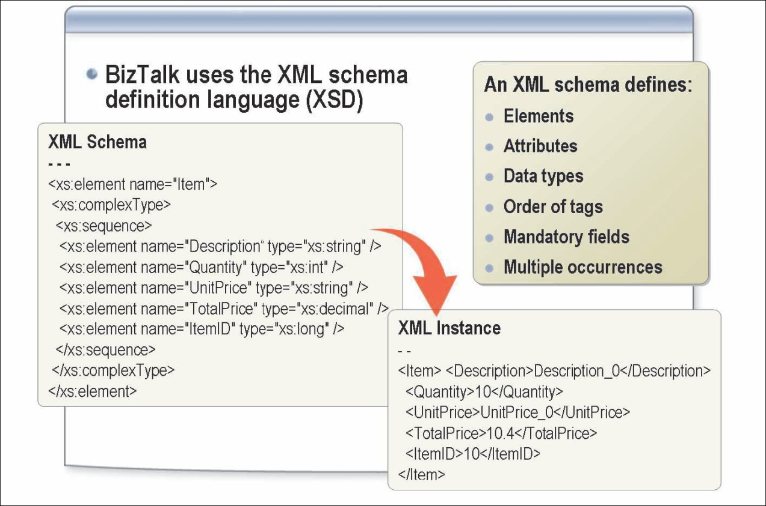
BizTalk Schemas
Each unique document type requires a separate schema that defines the records and fields contained in that document. The XML schema defines:
The elements, attributes, and data types that appear in a document.
The ordering of tags in the document.
Fields that are mandatory or that might occur multiple times in a single document.
Notes:
BizTalk Server was one of the first applications specifically designed to work with data in XML format. All documents (messages) that will be internally processed by BizTalk must first be converted to XML. All XML artifacts that are created by BizTalk are fully World Wide Web Consortium (W3C) compliant. This means that schemas created using other tools can generally be used by BizTalk and vice versa.
Namespace. An XML namespace is a W3C standard for providing uniquely named elements and attributes in an XML instance. An XML instance may contain element or attribute names from more than one XML vocabulary. If each vocabulary is given a namespace, the ambiguity between identically named elements or attributes can be resolved.
Element. An XML element is a construct used to organize information in a hierarchical manner. XML elements can either be simple data types (such as strings, decimals, and unsigned bytes) as defined in W3C standards, or they may be a complex type containing other elements and/or attributes. Elements and attributes are case sensitive; that is, Customer is not the same element name as customer or CUSTOMER.
Attribute. An XML attribute is a construct used to associate additional information contained with an XML element. Unlike elements, attributes cannot be nested. Attributes can be associated with any of the simple data types, but because they cannot be nested, they cannot be a complex type.
In the following example, Customer is an element with a value of Contoso. ID is an attribute of the Customer element and has a value of 12345.
<Customer ID=”12345”>Contoso</Customer>
XML Schema Definition Language (XSDL). The XML schema definition language is used to create schemas that represent the message formats that BizTalk will process. Schemas define nodes such as required and optional fields, recurring fields, and order. An instance message can be validated against an XSD to verify that the format is valid.
XML Path Language (XPath). A language used for navigating through the hierarchy of an XML document. For example, XPath can be used to select data in an XML document that matches a certain criterion or to perform comparisons on retrieved data.
Extensible Style Sheet Language Transformation (XSLT). A language definition for XML data presentation and data transformations. Data presentation refers to how data is formatted for display purposes in a specific format or style. Data transformation refers to how data is transformed and exchanged. For example, a purchase order could be converted from the format submitted by a trading partner to the format required for your internal processes.
Document Object Model (DOM). The DOM provides a mechanism for navigating through a message. When working with XML documents, the DOM is often used to manipulate and query XML data. In BizTalk, when references are made to the XML DOM, it is usually presumed that the message is being loaded into memory, which results in slower processing than would be experienced if the data were simply being streamed.
Web Services Description Language (WSDL). An XML format that describes the capabilities and characteristics of a Web service. BizTalk can both publish and consume Web services. That will be discussed in module 12.
Simple Object Access Protocol (SimpleSOAP). Defines a simple way of sending XML messages across the Internet. SOAP is used in BizTalk Server in conjunction with Web services.

Slide 40
What Are XML Namespaces?
Namespaces
Provide unique names for elements and attributes
Prevent naming conflicts with other schemas
Use the xmlns attribute to declare the namespace the element belongs to
A prefix is added to the declaration to remove ambiguity
<salesReport>
<customer id="Fabrikam">
<sales>
<id>widget1004</id>
<unitsSold>100</unitsSold>
<price currency="USD">35</price>
</sales>
</customer>
</salesReport>
<salesReport xmlns="http://adventure-works.com/salesReport">
<customer id="Fabrikam">
<sales>
<id>widget1004</id>
<unitsSold>100</unitsSold>
<price currency="USD">35</price>
</sales>
</customer>
</salesReport>
<salesReport xmlns="http://adventure-works.com/salesReport" xmlns:prod="http://adventure-works.com/products">
<customer id="Fabrikam">
<sales>
<id>widget1004</id>
<unitsSold>100</unitsSold>
<price currency="USD">35</price>
</sales>
</customer>
</salesReport>
<salesReport xmlns="http://adventure-works.com/salesReport" xmlns:prod="http://adventure-works.com/products">
<customer id="Fabrikam">
<sales>
<prod:id>widget1004</prod:id>
<prod:unitsSold>100</prod:unitsSold>
<prod:price prod:currency="USD">35</prod:price>
</sales>
</customer>
</salesReport>
Notes:
XML Namespaces
XML messages (instances) may contain elements or attributes from more than one XML vocabulary. If each vocabulary is given a namespace, the ambiguity between identically named elements or attributes can be resolved. Element names within a namespace must be unique.

Slide 41




How Does BizTalk Use XML Namespaces?
Message A TargetNamespace= “NewOrders”
BizTalk Server
Schema A TargetNamespace= “NewOrders”
Message B TargetNamespace= “OrderUpdate”
Schema B TargetNamespace= “OrdersUpdate”
Message C TargetNamespace= “Inventory”
No Match
Notes:
When an XML message is received by BizTalk, the default namespace and root node name are extracted from the message. These values are concatenated (targetNamespace#rootNodeName) and are referred to as the Message Type. It is important that the Message Type be unique so that BizTalk can non-ambiguously determine the correct schema to be applied to the instance.
For non-XML message instances, a property defined in the pipeline will specify the schema to be applied. Schemas used for flat file processing will have a root node name and a target namespace and will therefore have a message type. These values should provide for uniqueness but are not as critical. More information about these properties will be provided later in this module.

Slide 42
Supported BizTalk Schema Types
Message Type | Details
XML | Supports native XML message types Defined in XML Schema definition language (XSD)
Flat File | Supports delimited or positional file formats XML tags used to represent values Tag information stored using the annotation capabilities of XSD
EDI | Specially formatted text message BizTalk supports EDIFACT and X12 formats XSD annotations used to define format
Item
Description
Quantity
UnitPrice
TotalPrice
ItemID
Status
Node
Structure
Start
Length
Description
Delimited
0
50
UnitPrice
Delimited
50
10
Quantity
Delimited
60
10
TotalPrice
Delimited
70
10
ItemID
Delimited
80
10
Status
Delimited
99
1
ISA:00: :00: :01:1515151515 :01:515151 :041201:1217:U:00403:000032123:0:P:*~GS:CT:99887766 55:1122334455:20041201:1217:128:X:004030~ST:831:00128001~BGN :00:88200001:20041201~N9:BT:88200001~TRN:1:88200001~AMT:2:10
Notes:
Schema Types
BizTalk Server 2010 can natively process messages in XML flat file and EDI message formats. BizTalk is extensible, and custom message types can be created in addition to those supported out of the box.
XML Schema
An XML schema defines the structure of XML messages. XML messages are arranged in a hierarchical format that is defined by the schema. Messages are identified and validated against their associated schema.
Flat File Schema
A flat file schema defines the structure of messages that use a flat file format. Flat files can be either delimited or positional. Because XSD does not natively support the flat file structure, BizTalk uses the annotation capabilities of XSD to store this extra information within the XSD schema. BizTalk defines a rich set of specific annotation tags that can be used to store all of the required additional information.
EDI Schema
BizTalk supports the creation and use of schemas that represent various EDI document formats such as EDIFACT and X12. An EDI message is a variation of a text message and does not use typical delimiters such as carriage returns and linefeeds. As with flat file schemas, BizTalk uses the annotation capabilities of XSD to store the extra information related to the format of the EDI messages.
EDI messages are beyond the scope of this course. Refer to the BizTalk help files for additional information on EDI schemas and their uses.

Slide 43
Flat File Structures
Delimited flat files
Fields separated by a specified delimiter
Have a common end-of-record terminator
John, Smith, 123 Main St., “Learning BizTalk Server 2010”
Positional flat files
Fields are fixed length
Have a common end-of-record terminator
John Smith 123 Main St. Learning BizTalk Server 2010
Notes:
Delimited Files
A delimited file contains one or more fields separated by a delimiter character. This character is frequently a comma (,) or pipe symbol (|) but could be any character.
Positional Flat Files
A positional flat file is made up of records that have a common end-of-record terminator (delimiter), for example, a carriage return, and fields that have a fixed length.

Slide 44
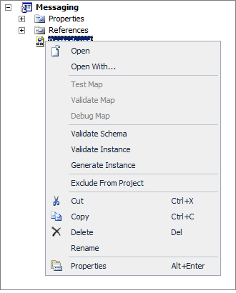
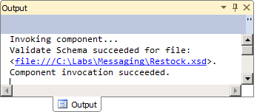
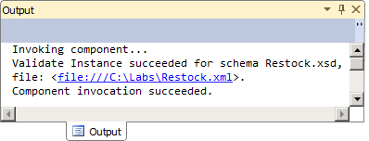
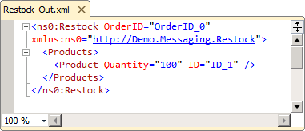
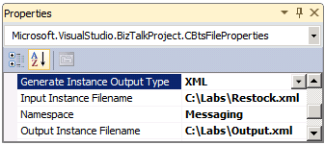
Testing a Schema
Validate XSD
Validate XML
Create XML

Slide 45
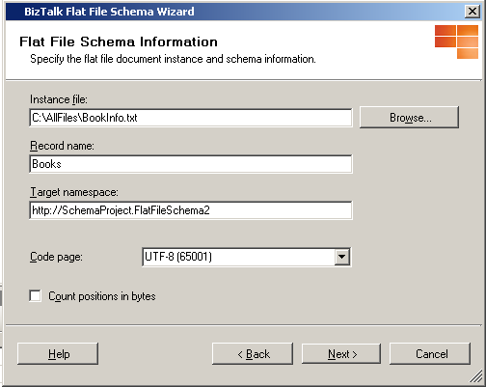
Using the Flat File Schema Wizard
Flat File Schema Wizard
Graphical tool for defining flat file schemas
Can define schemas for delimited or positional flat files
Notes:
The Flat File Schema Wizard provides a series of steps that allow you to quickly generate an XSD for even quite complex flat file messages. Once this base XSD has been created, it can then be opened by using either the BizTalk Schema Editor or another schema design tool and edited further if necessary.

Slide 46
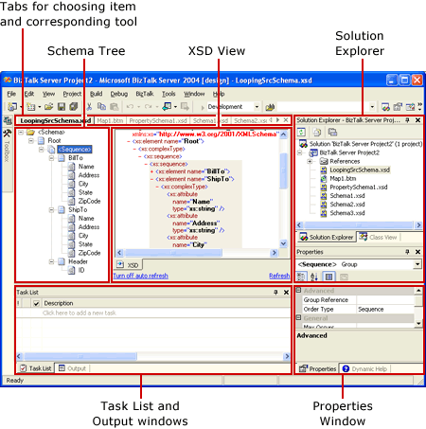
Editor Overview
Notes:
The Flat File Schema Wizard provides a series of steps that allow you to quickly generate an XSD for even quite complex flat file messages. Once this base XSD has been created, it can then be opened by using either the BizTalk Schema Editor or another schema design tool and edited further if necessary.

Slide 47
Introduction to BizTalk Maps

Slide 48
What Is a BizTalk Map?
A map defines the correspondence between records and fields in two different schemas
Data Transformation
Data Translation
Perform computational and other data operations
Copy the data from one message to another
Map
Source Schema
Destination Schema
PO
PurchaseOrder
PO
PO_Number
Status
Date
ItemID
Item_No
Change the format of data between messages
Example: translate between a flat file and an XML file
Qty
Quantity
UnitPrice
Order_Status
Date
Notes:
Map. You create a map when you want to transform or translate data between message formats.
BizTalk Mapper. A visual tool, hosted within Microsoft Visual Studio®, for constructing BizTalk maps, which define data transformations.
Data transformation. The process of converting an XML document that conforms to one schema into an XML document that conforms to another schema. A transformation can simply change the formatting applied to the data, but more often, data transformation results in some kind of structural change to the document. For example, a system that automates purchase order processing will typically transform purchase order records into one or more invoices.
BizTalk map. A file that defines the correspondence between the records and fields in one schema and the records and fields in another schema. BizTalk maps are implemented in XML Extensible Stylesheet Language Transformations (XSLT).
Extensible Stylesheet Language Transformations (XSLT). An industry-standard specification defined by the World Wide Web Consortium (WC3) for expressing transformations between two documents. The XSLT generated by BizTalk is fully W3C compliant.
Data translation. A special case of data transformation that involves changing the format of an instance message, typically from non-XML (EDI or flat-file) to XML format, or vice versa. For example, if your internal processes utilize XML data, but your trading partner needs to receive messages in a flat-file format, you can perform the necessary translation before you send such messages to the trading partner. Data translation can be especially helpful in solving enterprise application integration problems by rendering a given type of message into alternative formats required by existing systems.
Functoid. An executable module that performs a specific calculation or data manipulation. Functoids provide BizTalk map developers with the ability to create richer transformations than what is provided by XSLT on its own.

Slide 49
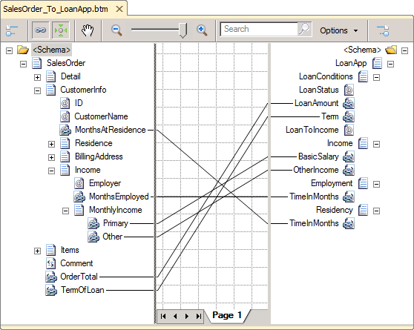
Creating a Map by Using the BizTalk Mapper
BizTalk Mapper
Integrated within Visual Studio
Starts when a map is opened or added to a project
Source and destination schemas must be part of the project or contained in a referenced assembly
Source Schema
Map Grid
Destination Schema
Notes:
The BizTalk Mapper tool, which is integrated into Visual Studio 2010, starts automatically when you either add a new map to a BizTalk project or open an existing map (a .btm file). To create a map, you must specify the source schema and the destination schema. The source and destination schemas must either be part of the current BizTalk project or be in a referenced assembly.
BizTalk Mapper Views
The BizTalk Mapper view consists of three panes within the Visual Studio interface:
Source schema pane. Displays the schema of incoming instance messages. The links that define the mapping originate from the source schema tree view, passing through the map zone and ultimately to the destination schema tree view.
Map grid view pane. Shows the links and functoids that control how data in a source instance message is transformed to the destination schema. You work actively in this view to construct your map. The map grid can have multiple pages, which can also be named. This is helpful as maps become more complex.
Destination schema pane. Provides a tree view of an instance message as it will look after being processed by a BizTalk Server destination schema.

Slide 50
Creating a Map by Using the BizTalk Mapper
Link Type | Usage
Simple link (one-to-one) | Create a single link by dragging and dropping Can be made between nodes or records
Structure link (multiple) | Create multiple links simultaneously Relevant schema structures must be the same Use when node names are different but order is the same (or similar)
Name-matching link (multiple) | Create multiple links simultaneously Record or field names must match Similar but not identical schema structures
Record
Order
PO
PO No
Status
Date
ItemID
Item No
Record
Order
PO
PO No
Status
Status Flag
ItemID
Item No
Record
Order
PO
Status
Status
Item
Item
PO
Notes:
You can specify each individual link between two schemas yourself, or you can allow the BizTalk Mapper to specify links automatically. When you allow the BizTalk Mapper to automatically specify links, you must still choose between two options: Link by Name, or Link by Structure.
BizTalk Mapper Link Types
The BizTalk Mapper supports the following types of linking:
Simple linking. Use simple linking between individual nodes. To create a simple link, drag a node from the source schema, and then drop it onto the target node in the destination schema.
Structure linking. Use structure linking when the structure of the records being linked in your source and destination schemas are the same or very similar. Structure linking can be applied to the entire schemas or just to parts of each. By performing a structure link from a record in a source to a record in a destination schema, the subordinate nodes will automatically be linked. To create a structure link between portions of your source and destination schemas that have matching structures, hold the SHIFT key while linking the relevant records. After you link the records, links are automatically created for all of the subordinate records and fields for which a match is found.
Name-matching linking. Use name-matching linking when the structure of the records being linked in your source and destination schemas are somewhat similar and have matching record and field names, but have more structural exceptions than would be practicable for structure linking. The new BizTalk 2010 Mapper employs a new predictive name matching algorithm that creates links between nodes that have similar names, and are likely matches, even though the names may not be exact matches.

Slide 51
Basic and Complex Map Links
Mapping Operation | Usage
Basic | Most common type of mapping Values simply copied from input message to output message Supports most types of transformations and translations
Complex | Records can occur multiple times for a single message (looping) Source schema must specify repeating element Compiler will automatically generate an XSLT for-each loop
Record
Order
PO
PO_Number
Status
Date
ItemID
Item_No
Qty
Quantity
UnitPrice
Order_Status
Date
PO
Order
ID
PO_Num
Status
Date
Items
Detail
Item
FieldA
Field1
FieldB
Field2
Notes:
Basic Mapping
Basic mapping is the most common type of mapping. It involves copying a value from an element or attribute that occurs once in an input instance message to an element or attribute that occurs once in an output instance message
Complex Mapping
Complex mapping involves records or fields that can occur multiple times for a single instance of the Record or Field Element node in the schema tree. This type of variable count mapping is called looping.

Slide 52
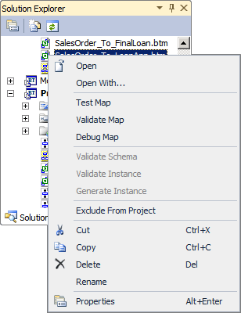
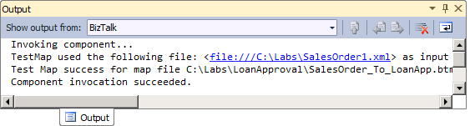
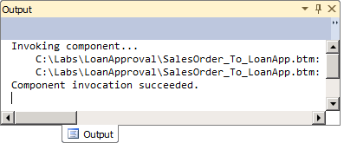
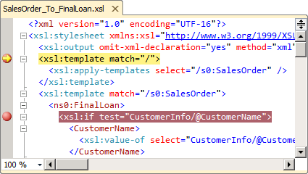
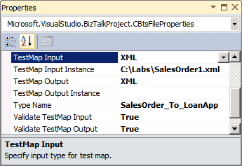
Validating, Testing and Debugging a Map

Slide 53
Data Manipulation with Functoids
Functoids
Map
Source Schema
Destination Schema
Use to manipulate mapped data
Can use predefined functoids or create custom functoids
Custom functoids can call scripts
Record
Order
PO
(..)
PO Number
Status
Date
ItemID
Item No
Qty
Quantity
UnitPrice
X
Order Status
Date
Total Price
BizTalk Mapper Extensions UtilityPack: BizTalk Mapper Extensions UtilityPack is a set of libraries with several useful functoids to include and use it in a map, which will provide an extension of BizTalk Mapper capabilities.
http://btsmapextutilitypack.codeplex.com/
Notes:
A functoid is an executable module that performs a specific calculation or data manipulation. A functoid can be used graphically when constructing BizTalk Server maps to provide the basis for richer transformations than what is provided by XSLT on its own.
The BizTalk functoids allow you to extend the functionality of the map to perform a variety of operations on data as the data is being transformed from the source message to the destination message.

Slide 54
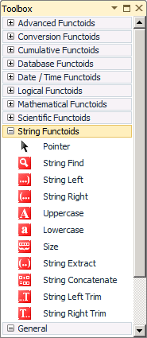
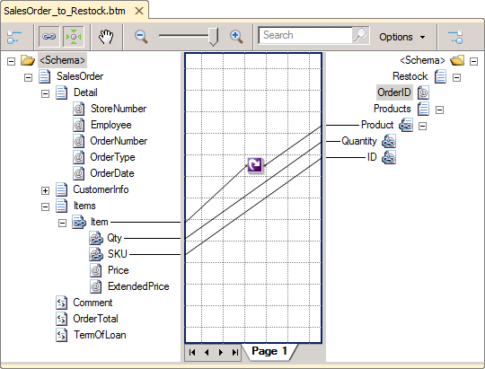

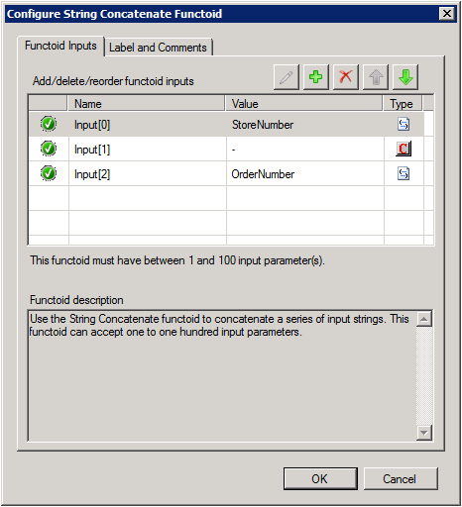
Using Basic Functoids
2
Link functoids to fields
1
Drag functoid from Toolbox to map
3
Configure functoid inputs

Slide 55

Using Map Grid Pages
Use pages to reduce complexity of a map
Grid Pages
Grid Preview
Create unlimited different pages
Isolate different parts of a map
Work with different parts of a map separately
Must create connected functoids on the same layer
Source Schema
Destination Schema
Record
Order
PO
(..)
PO Number
Status
Date
ItemID
Item No
Qty
Quantity
UnitPrice
X
Order Status
Date
Total Price
Find and work with a portion of a large map
Page 1
Page 2
Page 3
Page 4
Notes:
Maps for many types of business documents can require large numbers of links and functoids, rendering the map grid complex and difficult to understand. For improved readability, you can create separate map grid pages to isolate logical groupings of mapping operations into separate pages. You can then view and work with each grouping individually.
Note: All functoids that are connected together must reside on the same page. Also, if you delete a grid page, you delete all the links and functoids on that page. The new BizTalk 2010 Mapper allows you to cut/copy and paste links and functoids from one map page to another.

Slide 56
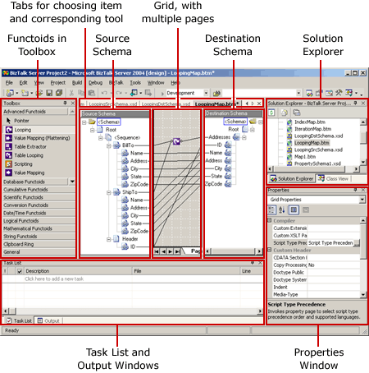
Editor Overview

Slide 57
Introduction to Pipelines

Slide 58



What Is a Pipeline?
Use pipelines to:
Normalize data from various formats to XML
Translate data from XML to various formats
Assemble and disassemble documents
Decode and encode documents
Decrypt and encrypt documents
Assign and verify digital signatures
Receive Pipeline
Orchestration
Send Pipeline
Pipeline Components
Notes:
Pipelines
Pipelines are software components that can process messages, either as the messages are received or just before they are sent out through a send port. A pipeline divides processing into categories of work called processing stages and specifies the sequence in which each stage of work is performed. Each stage of a pipeline contains one or more pipeline components (Microsoft .NET objects or COM objects) that can be configured to work with the specific requirements of the messaging solution or orchestrated business process.
Processing Stages
Pipeline processing stages can include functions such as decoding or encoding, disassembling or assembling, and decrypting or encrypting. Processing stages are implemented in a prescribed order that cannot be modified.
The processing stages for a pipeline depend upon its intended use. BizTalk Server provides two types of pipelines: receive and send. These two types of pipelines require separate categories of work, such as the encoding versus the decoding of a message. The pipeline also governs the process sequence by the use of policy files that specify the order in which each stage is to be executed. For instance, an incoming message must usually be decoded before it can be disassembled.

Slide 59
Pipeline Scenarios
Receive Pipelines:
Send Pipelines:
Decrypt inbound messages from trading partners
Split batched messages
Validate messages against known schemas
Verify the sender of a message for non-repudiation
Create custom processors to extend built-in functionality
Encrypt outbound messages to trading partners
Digitally sign outbound messages
Provide a wrapper for outbound messages
Validate messages against known schemas
Notes:
There are a number of reasons why you may need to implement pipelines in your BizTalk solution. By using pipelines, it is possible to modify the message in many different ways as it is being passed into and out of the MessageBox database.
Receive Pipelines
Receive pipelines can be used to process messages as they are received by BizTalk Server. For example, you can use receive pipelines to decode and/or decrypt messages (by using a private key) as well as verify the sender of messages as they are being received. This is important because messages exchanged over the Internet must frequently be encrypted, and it is necessary to confirm the identity of the sender of the message
Send Pipelines
Send pipelines are used to process messages as they are being sent by BizTalk Server. For example, you can use send pipelines to encrypt messages (using a public key), or digitally sign outbound messages (using a private key) as proof of who the sender is. Before a message is sent, you can also use the validate component of a send pipeline to ensure that a message is valid against a known schema.

Slide 60
Receive Pipeline Stages
Decode
Use to decode or decrypt messages
Use when secure document exchange is required
BizTalk includes a MIME/SMIME Decoder
Decode
!
Drop Here!
Disassemble
Disassemble
Use to parse or disassemble components
Use to probe messages and verify context properties
BizTalk Server includes an XML, flat file, and a BTF disassembler
Drop Here!
!
Validate
Validate
✓
Use to validate the format of an XML message
Use to compare a message to a known schema
!
Drop Here!
Resolve Party
Resolve Party
✓
!
Use to verify the sending party for a received message
Use with public certificates to validate sender
Drop Here!
Notes:
Receive pipelines are associated with receive ports. When a port receives a message via an adapter (or is called from within an orchestration), the message is passed to the pipeline for processing. The receive pipeline parses the initial message, with each component tentatively processing the message. The result of the pipeline process will be zero, one, or more messages that will make their way to the MessageBox and on to various subscribers.
Each of the four stages in a receive pipeline performs a specific function and can contain only components specified for use in that stage. Each receive pipeline stage can contain up to 255 components, which will all be executed in order with the exception of the disassemble stage, in which only one component will execute. The four stages are as follows:
Decode. This stage is used for components that decode or decrypt messages. For example, there is a built-in MIME/SMIME decoder pipeline component that can be used to decode MIME-encoded messages. Custom components for this stage could include a component to decode a compressed (zipped) file before further processing.
Disassemble. Use this stage if you need to parse or disassemble the inbound message. The components within this stage probe the message to see if the message format is recognized, and then, if the message format is recognized, one of the components disassembles the message. Tasks performed in this stage include conversions of flat-file messages to XML format and splitting of messages. In order for property promotion to occur, an appropriate (flat-file or XML) disassembler must be specified in this stage.
Validate. In this stage, messages are validated against a collection of schemas. Pipelines process only messages that conform to the schemas specified in this component, if present. If a message is received by the pipeline whose schema is not associated with any component in the pipeline, the message is not processed. Depending on the adapter, the message is either suspended or an error is issued to the sender. This stage runs once per message created by the Disassemble stage. The built-in validate component can be used in this stage as well as in other stages.
Resolve Party. In this stage, the certificate associated with the sender’s security identifier (SID) is mapped to the corresponding configured BizTalk Server party. If the message was digitally signed, the component uses the signature to look up a Microsoft Windows® identity in the BizTalk Server 2010 Configuration database. If the message carries the authenticated SID of a Windows user, this identity is used. If neither mechanism succeeds, the sender is assigned a default anonymous identity. Party resolution is an important feature for managing trading partner relationships. Not all adapters support party resolution.

Slide 61
Send Pipeline Stages
Pre-assemble
Pre-Assemble
Use to process a message before it is sent
Use for custom components only
Drop Here!
!
Assemble
Assemble
Use to assemble or serialize a message
Use to convert a message from XML to native format
Drop Here!
!
Encode
Encode
To encode or encrypt messages
Use when secure document exchange is required
BizTalk includes a MIME/SMIME decoder
Drop Here!
!
Notes:
Send Pipeline Stages
A send pipeline is responsible for processing documents before they are sent to their final destinations. The send pipeline accepts one message and produces one message for sending
By default, the send pipeline consists of three empty stages:
Pre-Assemble. This stage is a placeholder for custom components that should perform some action on the message before the message is serialized. This stage is run once per message and can contain between 0 and 255 components. All components in this stage are run.
Assemble. In this stage, components are responsible for assembling or serializing the message and converting it to or from XML. This stage accepts either 0 or 1 component, which if present will be executed once for each message. Possible uses for this stage include converting to a flat-file formatted message and placing an envelope wrapper around a message.
Encode. This stage is used for components that encrypt or encode the message, and it runs once per message. This stage can contain between 0 and 255 components, and all components in this stage are executed. If message signing is required, for example, place the MIME/SMIME Encoder component or a custom-encoding component in this stage. You may create a custom component to generate a message as a PDF file or to convert a message to compressed Zip format before sending it.

Slide 62
What Are the Default Pipelines?
Pipeline | Usage
Pass-Through Receive (PassThruReceive) | Contains no components No decoding, disassembling, or validation required
Pass-Through Send (PassThruTransmit) | Contains no components No encoding or assembling required Use for basic message routing
XML Receive (XMLReceive) | Contains the XML disassembler component Party resolution component for security No decoding or validation stage
XML Send (XMLTransmit) | Contains the XML assembler component Other stages empty by default
Notes:
Default Pipelines
When you create a new application, a reference to the Microsoft.BizTalk.DefaultPipelines assembly is automatically added to the project. This assembly contains the default pipelines provided with BizTalk Server. The default pipelines cannot be modified using the Pipeline Designer.
XML Receive Pipeline
The XML receive pipeline consists of all four stages; however, the decode and validate stages are empty. The disassemble stage contains the XML Disassembler component, and the ResolveParty stage runs the Party Resolution component, which resolves the certificated subject or the source security ID to the party ID.
XML Send Pipelines
The XML send pipeline consists of all three stages, with the assemble stage having an XML assembler and the other two stages being empty. The assemble stage ensures that the outbound XML is well-formed.
Pass-Through Receive Pipelines
The Pass-Through receive pipeline contains no components. It is used for simple pass-through scenarios in which no message processing is required. This pipeline is generally used when both the source and the destination of the file are known, and the message requires no validation, decoding, or disassembling. This pipeline is commonly used in conjunction with the Pass-Through send pipeline. Because this pipeline does not have a disassembler component, it cannot be used to route messages to orchestrations or to promote properties from within messages. Property promotion is discussed in detail in Module 5, “Routing BizTalk Messages.”
Pass-Through pipelines are typically used to process non-message data, such as graphics files, Microsoft Word and PDF documents, or files that are sent as attachments. The Pass-Through pipelines treat the message as a blob (raw message data) and simply place the content directly in the MessageBox database.
Pass-Through Send Pipelines
The Pass-Through Send pipeline contains no components. It is used for simple pass-through scenarios in which no message processing is necessary. This pipeline is the default pipeline that is used when you create a new send port. Because there are no components and no processing takes place, this pipeline is very efficient and should be used whenever practical. This pipeline is frequently used in conjunction with the Pass-Through receive pipeline when the message is not being processed by BizTalk but is simply being routed through BizTalk Server.
Flat-File Pipelines
There are no default flat-file pipelines. Any time flat-file messages need to be processed, it will be necessary to create a custom pipeline as outlined in the following topics. When any flat-file message is to be processed through BizTalk Server, the pipeline will have at least one disassembler in which the document property will identify the flat-file message format that the disassembler can process. Each flat-file disassembler can specify only one document schema; therefore, if the pipeline can process multiple flat-file message formats, multiple disassemblers will be required.

Slide 63
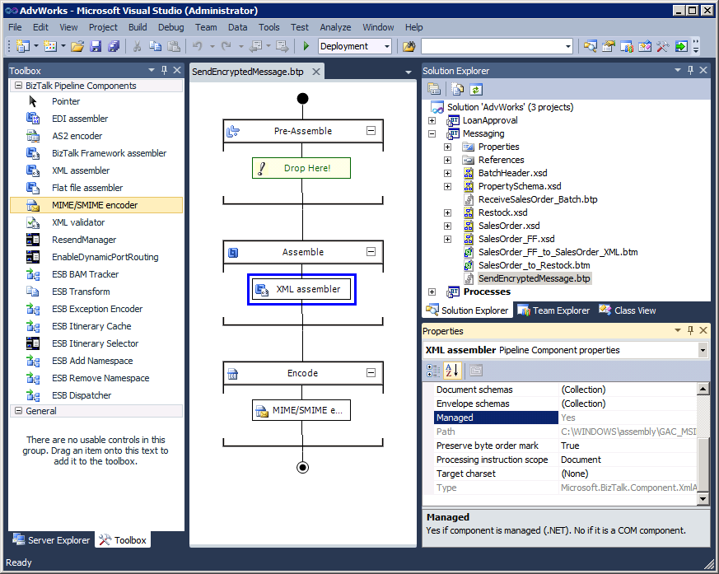
Using the Pipeline Designer
Pipeline Files
Properties Window
Toolbox
Design Surface
Notes:
The BizTalk Pipeline Designer is a feature in Microsoft Visual Studio® 2010. The Pipeline Designer provides a graphical representation of a pipeline and enables you to construct or edit send or receive pipelines for a BizTalk project

Slide 64
Introduction to BizTalk Orchestration

Slide 65
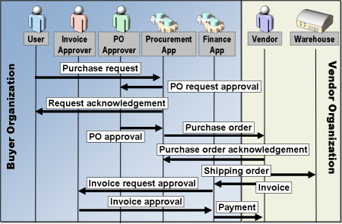
What Is BizTalk Server Business Process Automation?
Transformation of critical business activities from manual to automated processing
Increases coordination, higher productivity, and better efficiency
Implemented through BizTalk orchestrations and the Business Rule Engine
Notes:
Automação de processos de negócios permite a coordenação de processos de negócios, como a aprovação de um pedido de compra, com as pessoas e aplicativos de negócios, tais como planeamento de recursos empresariais (ERP), gestão de relacionamento com clientes (CRM), ou linha de negócios (LOB). Estes processos frequentemente começam como tarefas manuais que exigem integração e de entrada com muitos sistemas diferentes e indivíduos. O processo pode exigir dias, semanas ou meses para ser concluído
BizTalk Server 2010 fornece as ferramentas e tecnologias para automatizar esses processos de negócios.
BizTalk Orchestration
Como um programador, você pode implementar este tipo de integração de processos de negócios com uma aplicação customizada usando C #. No entanto, a criação, manutenção e gestão de processos de negócios complexos em linguagens de programação convencionais pode ser um desafio, caro e demorado. BizTalk Server 2010 permite que você crie esses processos de negócios de forma gráfica. Isso resulta em aplicações de automação de processos sendo desenvolvido mais rápido e de custo mais eficaz do que a construção do processo directamente em uma linguagem de programação. Ele também torna o processo mais fácil de entender, explicar e mudar.
Business Rule Engine
Com o tempo, as regras especificadas n uma orquestração pode mudar. As decisões incorporadas num processo de negócio do negócio em forma de regras são geralmente os mais voláteis. Por exemplo, um gerente de limite de gastos pode mudar, ou o limite de um cliente máximo de ordem pode mudar. BizTalk Server 2010 inclui o mecanismo de regras de negócio para que você possa directamente criar e modificar conjuntos de regras de negócio chamadas políticas. Essas políticas são criadas usando o Business Rule Composer e depois executado directamente pelo motor de regras de negócios

Slide 66






Modeling a Business Process
User
Invoice Approver
PO Approver
Procurement App
Finance App
Vendor
Warehouse
Purchase request
PO request approval
Request acknowledgement
Purchase order
Buyer Organization
PO approval
Vendor Organization
Purchase order acknowledgement
Shipping order
Invoice request approval
Invoice
Cancel Purchase request
PO Canceled

Slide 67
What Is an Orchestration?
Port Surface <<
>> Port Surface
Orchestration Designer
Receive PO
Is a visual design environment
Provides implementation shapes for modeling automated business processes
Saves business process model for later compilation
ReceivePOPort Operation_1 -> Request
Check Quantity
Denied
Else
Denied Msg
Send_Approve
SendApprvPort Operation_1 -> Request
Transform
SendDeniedPort Operation_1 <- Request
Send_Denied
BizTalk Orchestration
Is a run-time engine
Executes business processes
Compile and Deploy
BizTalk Server
Notes:
Orchestration Designer
BizTalk Orchestration Designer is a tool that is hosted within Microsoft Visual Studio®. The Orchestration Designer is used to create visual representations of your business processes. The actual underlying code that carries out the business process gets built into an executable module that runs on a BizTalk Server computer.
The Orchestration Designer design environment provides a versatile drawing surface and a comprehensive set of implementation tools. These tools include shapes (such as Send, Receive, Transform, and Construct) that you can use to coordinate all of your business-to-business orchestrations on the screen using a graphical interface. The addition of each shape generates code that becomes part of the eventual business process.
BizTalk Orchestration
BizTalk orchestrations provide the services that make it possible for you to design, execute, and manage business processes. An orchestration represents the underlying logic for processing messages similar to traditional procedural programming languages. An orchestration is a graphical rendering of the processing logic, providing many of the normal programming constructs as well as additional features needed to address requirements such as long-running transactions, parallel actions and decisions. An orchestration can be viewed as an event-driven, finite state machine in which the state-transition events are the arrivals of messages or ticks of the clock.
Run-Time Engine
The BizTalk orchestration run-time engine executes the orchestration by creating individual instances of the business process. The run-time engine coordinates multiple instances of a business process, ensuring, for example, that a response message gets routed to the correct orchestration instance, which it does by using a specialized routing pattern called correlation. For example, you may create a process involved with hiring new employees. For each employee, there are a number of messages that need to be sent and tasks that need to be performed. BizTalk Server can manage several instances of the orchestration for each new employee and correlate each incoming message to the correct orchestration instance.

Slide 68

How the BizTalk Orchestration Engine Works
Orchestration engine
Orchestration Engine
Creates orchestration instances
Maintains state of orchestrations
Performs resource optimizations
Provides reliable shutdown and recovery
Dehydrate
Rehydrate
MessageBox
Notes:
The BizTalk orchestration engine is a highly optimized service that monitors and executes orchestrations. The orchestration management tasks the orchestration engine is responsible for include:
Creating instances of and executing orchestrations.
Maintaining the state of a running orchestration instance so that it can be restored to memory when required.
Performing optimizations of running orchestrations to maximize scalability, throughput, and efficient use of resources.
Providing a reliable shutdown-and-recovery system.
Dehydration and Rehydration
When many business processes are running at the same time, memory and performance can be compromised. The orchestration engine solves these issues by performing the following actions on orchestration instances:

Slide 69
Orchestrating a Business Process
User
Invoice Approver
PO Approver
BizTalk
Procurement App
Finance App
Vendor
Warehouse
Purchase request
PO request approval
Request acknowledgement
Buyer Organization
Vendor Organization
PO approval
Purchase order
Purchase order acknowledgement
Shipping order
Invoice
Invoice request approval
Invoice approval
Payment
Notes:
Introduction
BizTalk orchestration is a flexible and powerful capability that provides various services and tools to enable you to design, automate, and manage business processes. Similar to traditional procedural programming languages, an orchestration represents the underlying logic for processing messages.
BizTalk orchestration provides a transactional programming model that includes support for exception handling and recovery from failed transactions. You can define two types of transactions when creating an orchestration:
Atomic transaction. Enables a transaction to automatically role back to a previous state in case the transaction does not successfully complete.
Long running transaction. Can span days, weeks, and longer time durations, contain nested transactions, and use custom exception handling to recover from error scenarios.
As a result, orchestrations provide you the flexibility to define the course of action in the event of a business process failure.

Slide 70
Scope and Group Shapes
Group
Process Loan Orchestration
Visually group shapes
Collapsible
Not saved as code
Receive Loan Application
Scope
Request Credit Report
Scope
Order Appraisal
Framework for organizing actions
Used for exception handling and transactional execution
Contains one or more blocks
Can have appended exception-handling blocks
Can have appended compensation blocks if transactional
Exception Handlers
Compensation
Sign Documents
Notes:
Scope Shape
A scope acts as a framework for organizing actions. You use it primarily for transactional execution and for exception handling. You also use a scope when you want to define variables, messages, and correlation sets that must remain local within the scope and when you need to use variables and classes that are non-serializable.
A scope contains one or more blocks or other nested scopes.
Group Shape
A Group shape is used to arrange actions in an intuitive and visually manageable way. You can use the Group shape as a placeholder for functionality yet to be added, or you can use it to make annotations about what actions take place within it. The name property on the Group shape can be up to 512 characters long. You can type annotations into the name property, and when the shape is collapsed, the entire name will be displayed.

Slide 71
Orchestration Flow Control Shapes
Shape | Use
Decide | To represent If/Else logic Define rule for each branch
Delay | To control the timing of the orchestration Specify pause time or predefined date or time
Listen | To wait for events to occur before proceeding Must use Receive or Delay as the first shape Follows the first condition met in the branch Can use as many branches as needed
Check Quantity
Rule
Else
Drop a shape from the toolbox here
Drop a shape from the toolbox here
Delay
Listen
Drop a shape from the toolbox here
Drop a shape from the toolbox here
Drop a shape from the toolbox here
Drop a shape from the toolbox here

Slide 72
Orchestration Flow Control Shapes (continued)
Shape | Use
Loop | To repeat actions while a condition is met Use Expression Editor to set the condition
Parallel Actions | Ensures that all branches complete before continuing Single-threaded execution. Does not run branches concurrently Used primarily for coordinating multiple receive shapes
Suspend | To suspend a running orchestration Use Expression Editor to set the condition Administrator intervention required to resume
Terminate | To end a running orchestration immediately Can specify an error message string to help diagnosis
Loop
Drop a shape from
the toolbox here
Parallel Actions
Drop a shape from the toolbox here
Drop a shape from the toolbox here
Suspend
Terminate

Slide 73
Expression and Exception Shapes
Shape | Use
Expression | Enter any expression in an orchestration Use Expression Editor to define expression
Throw Exception | Explicitly throw an exception Exceptions are caught at present scope or at the next containing scope
Expression
Throw Exception
Notes:
Expression Shape
The Expression shape allows you to enter complex expressions into your orchestration easily and quickly; however, you cannot use it to enter an arbitrary amount of code. For example, you can initialize and manipulate the values of your orchestration variables, assign values to dynamic ports, or make a .NET call to run an external program. You use the Expression Editor to define the expression.
Throw Exception Shape
You can explicitly throw exceptions in an orchestration by using the Throw Exception shape. When the throw is performed, the runtime engine will search for the nearest exception handler that can handle the type of exception being thrown. After a matching exception handler is found, control is transferred to the first statement of the exception handler. If the search for matching exception handlers fails, the orchestration halts. Transactions (which will be discussed in the next module) can help you minimize the impact of such an occurrence.

Slide 74
Nesting Orchestrations
Invokes another orchestration synchronously
Can pass parameters in and out
Calling orchestration waits
Invokes another orchestration asynchronously
Can pass in parameters
Calling orchestration continues processing
Call Orchestration
Start Orchestration
Notes:
Call Orchestration Shape
The Call Orchestration shape is used to invoke another nested orchestration synchronously, which means that the enclosing orchestration waits for the nested orchestration to finish before continuing.
You can specify parameters that will be passed to the nested orchestration. Parameters can be messages, variables, port references, role links, or correlation sets. Parameters can be defined as one way (in or out), or they can also be passed by reference as with a .NET method parameter. Passed-in port references, role links, and correlation sets all perform in a way similar to that of self-addressed envelopes, which means that they supply the nested orchestration information that it can use to send information back to the enclosing orchestration.
Start Orchestration Shape
Similar to the Call Orchestration shape, the Start Orchestration shape can be used to nest other orchestrations; however, this nesting is asynchronous, which means that the flow of control in the invoking orchestration proceeds beyond the invocation without waiting for the invoked orchestration to finish its work.
As with the Call Orchestration shape, you can specify parameters that will be passed to the called orchestration. The Start Orchestration shape can only take in parameters; it cannot take out or reference parameters.

Slide 75
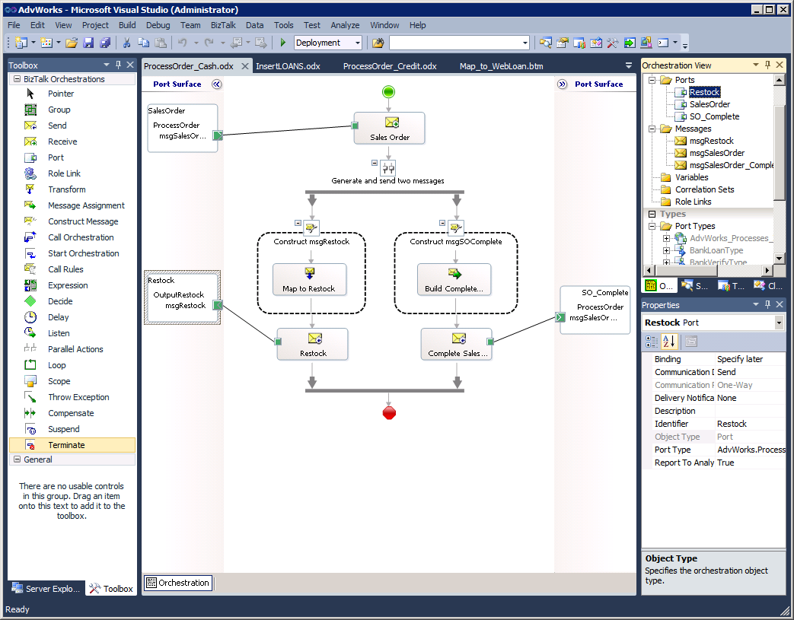
What Is the Orchestration Designer?
Orchestration View
Port
Surface
Port
Surface
Properties
Process Area
Toolbox

Slide 76
Introduction to BizTalk Adapters
Lesson 1

Slide 77
What Is an Adapter?
Adapters
.NET or COM software components
Connect BizTalk to specific applications and systems
Can use standard protocols (HTTP, FTP, POP3)
Can use proprietary communication mechanisms
Support one-way or two-way communications
Add metadata to data stream of received messages
Notes:
Adapters
BizTalk adapters are the first and last software components used by BizTalk Server to exchange messages with disparate applications and systems. An adapter is a software component that enables messages to be received or sent by BizTalk Server using a specific delivery mechanism. This mechanism is commonly a recognized standard, such as HTTP, FTP, or POP3, but it could also be a method of communicating with a proprietary third-party application, such as a vendor’s Enterprise Resource Planning (ERP) application.
How Adapters Work
The role of an adapter is to enable communications between BizTalk Server and external systems and trading partners. Users configure adapters by creating send ports and receive locations that define the properties for given instances of the adapter. Most adapters support both send and receive operations, whereas other adapters support communication in only one direction.
A receive adapter works in conjunction with a receive port and a receive pipeline to retrieve messages from the source location (an endpoint); it saves the messages in the MessageBox database. Each receive adapter has specific context information about the message (metadata) that is associated with the protocol that it supports. This metadata can include information such as the original file name, the time the message was received, and the sender information. The metadata is saved along with the message data and can be accessed by send ports, send port groups, and orchestrations when necessary for routing purposes and to make general processing decisions within an orchestration. For sending messages, the send port adapter and pipeline work together via the messaging engine to send the message from the MessageBox database to a specific endpoint.

Slide 78
Sources of Adapters
Adapter Sources
Standard BizTalk Server 2010 adapters
Microsoft add-on adapters
Third-party adapters
Custom adapters
List of Custom Adapters: http://social.technet.microsoft.com/wiki/contents/articles/12824.biztalk-server-list-of-custom-adapters.aspx
List of Third-Party Adapters: http://social.technet.microsoft.com/wiki/contents/articles/12956.biztalk-server-list-of-third-party-adapters.aspx
Notes:
Standard BizTalk Server 2010 adapters. These adapters, also known as native adapters, are included in the installation of BizTalk Server 2010. The standard adapters include Base EDI, FILE, FTP, HTTP, WebsSphere MQ, MSMQ, POP3, SMTP, SOAP, SharePoint and WCF adapters. Multiple instances of each adapter can be configured by adding multiple receive locations and send ports. The FTP adapter has been improved, adding support for secure FTP.
BizTalk Server 2010 Adapter Pack. Microsoft makes available additional specialized adapters for connecting BizTalk Server to a number of proprietary systems. The release of the BizTalk Server 2010 Adapter Pack includes updated adapters that support the latest versions of JD Edwards, Oracle eBS, SAP and Siebel. These adapters can be installed individually as required. A complete list of the BizTalk Server 2010 adapters is available on the Microsoft web site.
Third-party adapters. Third-party adapters can be purchased by companies who specialize in developing adapters or from companies that provide adapters to enable integration with their proprietary applications. Examples of third-party adapters include Lotus Notes, and CICS. Once the adapter has been installed, you can use the BizTalk Administration console to configure these adapters. If an adapter is no longer required, it can be removed without the need to reconfigure the BizTalk application.
Custom adapters. A custom adapter could be required if no adapter exists for a system or application to integrate with BizTalk Server 2010. Microsoft provides the BizTalk Adapter Framework documentation and a software development kit (SDK) toolkit for developers to use for creating custom adapters.

Slide 79
BizTalk 2010 – Adapters
Core Adapters
FILE
FTP
SFTP
MQ
SOAP
MSMQ
SMTP
POP3
...etc
WCF Adapters
WCF-BasicHttp
WCF-WsHttp
WCF-NetTcp
WCF-NetNamedPipe
WCF-NetMsmq
WCF-Custom
LOB Adapters
SQL Server
Oracle DB
Oracle EBS
Siebel
SAP
Notes:
Adapter Framework
Microsoft provides the BizTalk Adapter Framework to enable developers to create custom adapters for interfacing and integrating with a proprietary system or with a system unsupported by existing adapters. This framework provides a common means of creating and implementing adapters and includes the specifications for building BizTalk adapters using open standards based on Web Services. The Adapter Framework consists of a set of extensible APIs that enable developers to access relevant BizTalk Server services used to integrate applications and platforms. Once an adapter has been built for BizTalk Server by using the Adapter Framework, the standard BizTalk administration tools can be used to manage and configure the adapter. The Adapter Framework is provided as part of the BizTalk Server 2010 product SDK.

Slide 80
BizTalk 2010 – Adapters
Line Of Business Adapters (LOB)
SQL Server
Oracle DB
Oracle eBusiness Suite
Siebel eBusiness Applications
SAP
sqlBinding
oracleBinding
oracleEbsBinding
siebelBinding
sapBinding
Just Bindings!
Works for any .Net application!
Notes:
Adapter Framework
Microsoft provides the BizTalk Adapter Framework to enable developers to create custom adapters for interfacing and integrating with a proprietary system or with a system unsupported by existing adapters. This framework provides a common means of creating and implementing adapters and includes the specifications for building BizTalk adapters using open standards based on Web Services. The Adapter Framework consists of a set of extensible APIs that enable developers to access relevant BizTalk Server services used to integrate applications and platforms. Once an adapter has been built for BizTalk Server by using the Adapter Framework, the standard BizTalk administration tools can be used to manage and configure the adapter. The Adapter Framework is provided as part of the BizTalk Server 2010 product SDK.

Slide 81
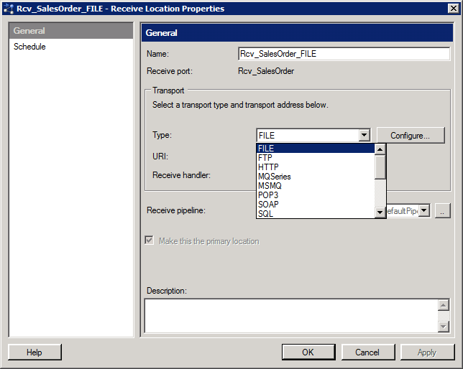
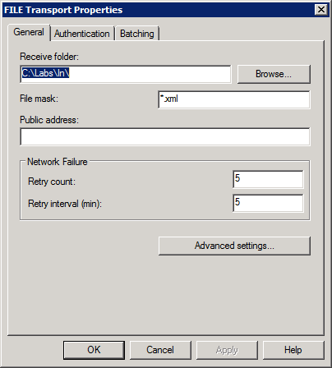
Configuring an Adapter
File adapter properties
Notes:
Adapter Configuration
Each adapter must be configured with specific properties to enable it to function. The properties differ depending on how the adapter will connect to the intended endpoint. For example, an FTP adapter has specific settings that are unique to the FTP protocol and the specific FTP server that it must connect to. This includes properties such as the polling interval, logon user name, and the password. Obviously, these properties would not be appropriate for the FILE adapter.

Slide 82
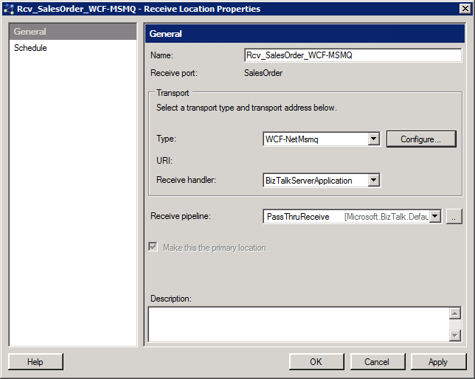
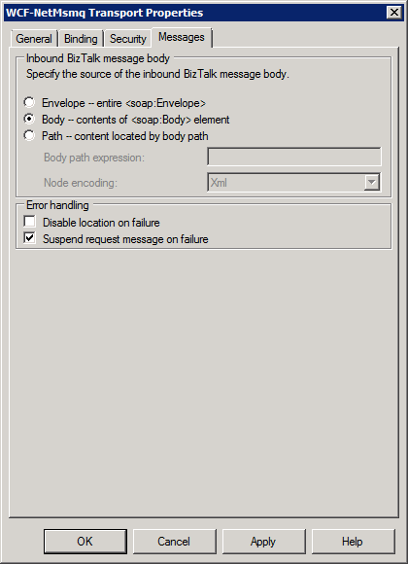
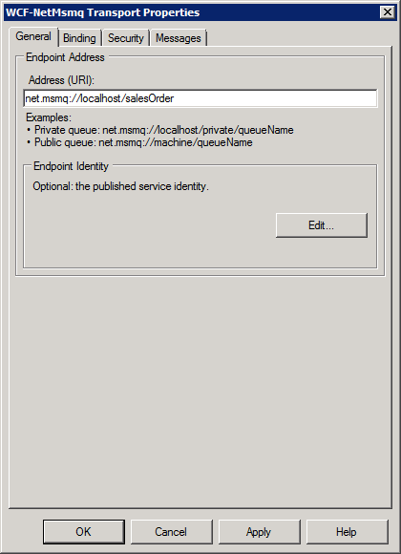
Integrating with WCF Adapters
1
2
WCF-NetMsmq adapter properties
Notes:
The BizTalk WCF adapters allow BizTalk Server to communicate with service-based interfaces of other applications, including database servers such as SQL Server 2008 and Oracle 11g. The WCF adapters offer a new and more flexible way to access data. The BizTalk WCF adapters include five physical adapters that represent the WCF predefined bindings:
WCF-WSHttp: This adapter provides WS-* standards support over the HTTP transport.
WCF-BasicHttp: This adapter provides communicates with ASMX-based Web services and clients and other services that conform to the WS-I Basic Profile 1.1.
WCF-NetTcp: This adapter provides WS-* standards support over the TCP transport.
WCF-NetMsmq: This adapter provides support for queuing by leveraging Microsoft Message Queuing (MSMQ) as a transport.
WCF-NetNamedPipe: This adapter provides secure optimization for on-machine cross-process communication using named pipes.
WCF-Custom: This adapter allows you to configure a WCF binding and the behavior information for the receive location and send port, and take advantage of the WCF extensibility features.
WCF-CustomIsolated: This adapter allows you to configure a WCF binding and the behavior information for the receive location running in an isolated host, and take advantage of the WCF extensibility features over the HTTP transport.
WCF-Custom Adapter
The WCF-Custom adapter replaces the SQL adapter that was included in previous versions of BizTalk. With the WCF-Custom adapter, BizTalk Server can exchange messages to and from a Microsoft SQL Server™ 2008 and Oracle 11g databases

Slide 83
Introduction to Business Rules

Slide 84
What Are Business Rules?
Business Rule Engine:
Use business rules to:
Enables policy changes in real time
Enables policy changes without recoding or rebuilding the orchestration
Trigger notifications
Automate approvals
Reroute documents
Business Event | Business Decisions | Rules
Receive Purchase Order | Is customer known? | If customer ID exists, then customer is known
 | Is product known? | If product ID exists, then product is known
 | Is product available and in inventory? | If quantity on hand < reorder quantity, then reorder product
Notes:
Business Rules
Business rules are statements that govern the conduct of business processes. A policy is a collection of related rules that are evaluated together, for example, a bank’s loan approval policy might be composed of several different rules that need to be evaluated. The policy is executed, and each rule is evaluated and possibly applied.
Each rule consists of a condition (an if clause) and a resulting action (a then clause). The conditions and actions can be quite simple or very complex. The condition is evaluated, and if it evaluates to True, the specified actions are performed by the rule engine. Unlike in most programming models, there is no else action. For example, if you want to perform an action on all purchase orders, but the action varies based on the total order amount, you would need to create two rules, one for purchase orders with a total of less then $1,000 and one rule for purchase orders with totals greater than or equal to $1,000. These two rules would make up the discount policy.
Within a policy, the various rules can have different priorities assigned. These priorities do not modify the order of evaluation but rather the order that the rules are fired in. That is, if multiple rules are to be fired (on the agenda), the priority will determine the order that the rules are applied. In this case, the rule that has the highest assigned priority will be fired.

Slide 85
What Are Rules, Policies, and Vocabularies?
Term | Description
Rules | Set of conditions and one or more consequent actions Return either True or False
Policy | Contains a logical grouping of rules Published and deployed to a production environment
Vocabulary | Collection of definitions for rule conditions and actions Assigns a friendly name to the definition
Notes:
Rule
Business rules are statements that govern the conduct of business processes. Business rules consist of a condition and one or more consequent actions. Conditions are true/false, otherwise known as Boolean expressions, that consist of one or more predicates applied to facts. Multiple conditions can be combined to provide for complex computations. Complex conditions can be constructed by joining multiple simple conditions using AND, OR, and NOT modifiers. For example, when evaluating a customer order, you could have a rule such as: If customer exists AND total order amount > 1000 OR if customer exists AND customer rating = excellent THEN set discount amount = 10%.
Policy
Policies are logical rule sets. You compose a version of a policy, save it, test it by applying it to facts, and when you are satisfied with the results, publish it and deploy it to a production environment. Policies are versioned and deployed, so if a rule changes, you simply create a new version of the policy, test the policy, and then deploy it. You do not have to recompile or modify orchestrations or other business processes that are using a particular business policy.
When called from an orchestration, the Business Rule Engine will always execute the latest version of a policy. Changes made to a business rule policy will be immediate. The next time the policy is called from an orchestration, the most recently deployed version will be used. After it is published, a business rule policy is immutable and can be changed only by creating a new version.
Vocabulary
Vocabularies are user-defined names for the facts used in rule conditions and actions. Vocabulary definitions render rules easier to read, understand, and share for the various workers within a particular business domain. For example, the source location for a particular fact might be a field in a particular record within a database, represented as an SQL query. Instead of employing the SQL query (an abstract procedural statement, difficult for most people to memorize or recognize) in the rule, a name meaningful to all the relevant parties in the development and deployment process can be associated with the query by creating a vocabulary definition. When you create a new vocabulary definition, you can choose from one of the following:
A constant value, a range of values, or a set of values
A .NET class or class member
An XML document element or attribute
A database table or column
Creating the necessary vocabulary for business rules makes reading, comprehending, and updating the business rules much easier than without using vocabularies. In addition to the vocabularies you can create, the Business Rule Composer uses predefined vocabularies for the predicates and functions used in the rule evaluations and actions.
Rule Store
The rule store is a repository for business policies and vocabularies. Policies and vocabularies are deployed to the rule store. The rule store is by default the Business Rule Database (BizTalkRuleEngineDb). This database is created when configuring business rules for the BizTalk group. Additionally, policies and vocabularies can be exported to an XML file to simplify modification and deployment between test and production environments.

Slide 86

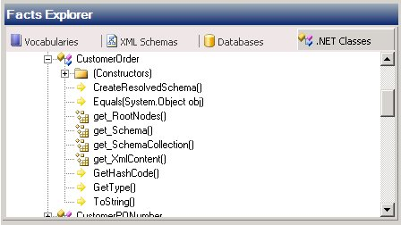
How Rules and Facts Work
Policy
Rules
Rule Set
Conditions: true/false expression with predicates
Actions: initiated when rule condition is met
Facts: data upon which rules operate
Rules
Facts derived from:
XML schemas
SQL databases
.NET classes
Predefined and custom vocabularies
Notes:
Business Rules
A business rule consists of a condition and one or more resulting actions. As mentioned before, business rules are If/Then conditions, and there is no Else clause. Each business rule either returns True or False.
Conditions
A condition is a True/False (Boolean) expression that consists of one or more predicates applied to facts. Predicates can be combined with the logical connectives AND, OR, and NOT to form a logical expression that is potentially quite large but that will always evaluate to either True or False.
Actions
An action is the functional consequence of condition evaluation. If a rule condition is met, a corresponding action or actions are initiated. Actions are represented in the Business Rule Framework as Microsoft .NET–based objects or as set operations on XML documents or database tables. For example, if a business rule that checks whether or not a customer is preferred returns true, you could then call a method of a .NET class to execute code in the class. You could also update elements or attributes in an XML schema document, or you could update data in a Microsoft SQL Server™ database. You can execute more than one action within the THEN clause.
Facts
Facts are the data that rules use to make decisions. Facts can be derived from multiple data sources and must be fed into the rule engine through pre-defined vocabularies, XML schemas, .NET classes, or database row sets. Many facts are instance facts that will be different for each firing of the rules. For example, the customer name and account number fields in a PO message are instance facts. Other facts may be long term. For example, interest rates usually change infrequently and do not need to be looked up each time a rule is fired. Long-term facts are determined once and then held in the cache until refreshed, whereas instance facts are determined for each rule execution. A fact can be configured as a long-term fact by setting the Fact Retriever property for each version of the policy in the properties window for the version of the policy. A fact retriever object must be created to be able to fetch the facts from a persistent storage and present them to the policy object.

Slide 87

Business Rules Orchestration Scenarios
Call Rules
Call Rules
Call Rules
{ }
{ }
Preprocessing
Preprocessing
Decision Branch
Rule-Based Send
Rule-Based Delay
Rule
Else
Post-Processing
Post-Processing
LogicA
LogicB
Post-Processing
Call rule engine to dynamically determine which orchestration to process the next step
Call rule engine for dynamic or variable delays
Call rule engine and determine path
Notes:
Common Orchestration Scenarios
Instead of having to code and recode constantly changing business policies and logic within your complex business processes, you can incorporate a call to the Business Rule Engine and thus allow information workers to update the rules as needed.
Overview
You can integrate business rules into your orchestrations to support a variety of scenarios:
You can use rules to determine whether another business process needs to be executed. For example, after successfully placing a customer order, you might want to call a second orchestration that handles the shipping of orders.
You can use rules to evaluate business logic and to determine when a business process requires a variable delay. For example, you might set up a loop to check on the status of an item to see if the item is in stock. After initially checking the stock of an item that is not available, the rule delay would be one minute. The next time, the rule would wait five minutes before executing, the following time, the rule would wait 30 minutes before executing, and so on.
You can use rules to determine the execution path for a business process, basing the determination on the results of the rule execution. For example, if the customer submitting the purchase order does not exist in the database, you could route the document to another business process to add the customer to the database before continuing to process the purchase order.

Slide 88




Identifying Business Rule Personas
Developers
Information Workers
Integrate policies within an orchestration
Define policies and vocabularies
Use business vocabularies to design and test policies
Administrators
Secure, deploy, and migrate policies
Track policy execution
Notes:
Overview
The Business Rules Framework incorporates a graphical user interface—the Business Rule Composer—that developers, information workers, and administrators can all use in various ways to develop and apply both rules and policies.
Developers can:
Create the orchestrations from which the business rules will be called, and they define the action to be taken when a decision is returned to the orchestration. As long as the decision path within the orchestration does not change, the orchestration will not need to be redeployed.
Create the initial business rule policies and create vocabularies to make it easier for information workers to edit and understand business rule policies.
Information workers can:
Design, test, and manage business policies. Changes made to a BRE policy will be executed from an orchestration without having to recompile and redeploy the BizTalk assembly. The BRE always calls the latest deployed version of the policy.
Administrators can:
Secure business rule policies. By default, when a new policy or vocabulary is created in the rule store, only the user who created it and the rule engine administrator have both read/execute and modify/delete access. The rule engine administrator can configure which users have the access level, or rights, to perform different operations (processes operate under user credentials).
Deploy business rule policies from one physical environment to another. Deploying business rules to other physical environments is accomplished by using the Rules Engine Deployment Wizard and is covered later in this module. Rules can also be exported and imported using Microsoft Windows® Installer (MSI) packages.
Monitor the results of executed business rules by using the BizTalk Administration Console. This tool allows auditing of the rules-based decision made within each orchestration instance.

Slide 89
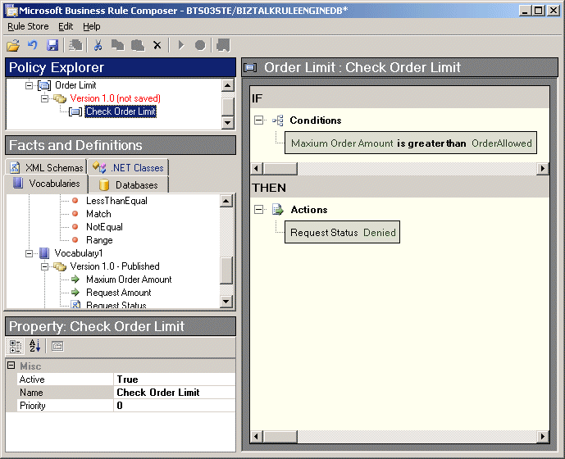
Composing Business Rules
Policies
Create versions of vocabularies
Create vocabulary definitions
Compose policies
Publish vocabularies and policies
Vocabularies
Definitions
Rule Composer
Notes:
Business Rule Composer
The Business Rule Composer is a graphical user interface that allows you to create business rule policies, which contain one or more business rules. These rules can evaluate facts to determine if specific actions should be performed. To assist in humanizing these rules, vocabularies can be created that provide a user-friendly alias to the terms and conditions. Multiple versions of the policies and vocabularies can be created, tested, published, and deployed using the Business Rule Composer to make management of these artifacts easier.
Create Business Rule Policy
A policy is a collection of rules. Each rule is a conditional comparison of facts, which if the comparison evaluates to True causes the actions defined in the rule to be executed. Rules are constructed in the Rule Composer pane by adding predicates and facts (which may be direct facts or may be based upon vocabularies) and defining actions. AND, OR, and NOT operators can be added to conditions to provide for complex comparisons.
Facts and actions are added by dragging them onto the Rule Composer design surface.
Testing, Publishing, and Deploying a Policy
When a version of a policy is defined to the satisfaction of the business analyst, the policy should be tested prior to publishing it. The act of publishing the policy to the Rule Store makes the policy available to the BRE. By default, the BRE uses a SQL Server database as the Rule Store. However, rules can be exported to an XML-based Rule Store as well. Once published, policy versions are immutable and cannot be changed without creating a new version. Remember that rules must also be deployed before they can be used by other applications.

Slide 90
Introduction to Business Activity Monitoring

Slide 91

Gaining Visibility into Business Processes
How many orders processed were over $10,000?
What is the average cycle duration per order?
What is the order trend for product XYZ over the past 24 hours?
Business Analyst
Order Process Milestones
Received Order
Cancelled Order
Delivered Order
Notes:
Overview
Business Activity Monitoring (BAM) is a tool for monitoring and analyzing data from business process information sources. The data is presented in a real-time view of business state, trends, and critical conditions. BAM’s open application programming interface (API) can be used to gain visibility into data external to BizTalk processes, such as archival data or other non-BizTalk processes and systems. BAM gives business analysts the data they need when they need it, enabling them to make better business decisions based on more relevant data.
BAM allows you to determine how your business is performing by answering questions such as:
How long did it take for this process to be approved?
How quickly was this order filled after it was received?
How many process cycles occurred in the last month? In the last year?
How many purchase orders were processed last week?
How much is our total revenue this year so far?

Slide 92



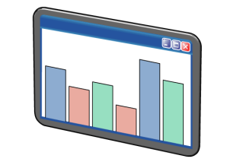
What Is Business Activity Monitoring (BAM)?
BAM allows users to:
Business Processes
View aggregate data related to thousands of instances of a business process
View a single instance of a business activity
Browse to related instances of business activities
Search for instances of a specific business activity
Browse aggregations by using key performance indicators (KPIs)
Filter activities at a given stage of completion
Define charts, reports, KPIs, and alerts
Business Activity Monitoring Databases
Business Analyst
Real-Time Monitoring
Notes:
Overview
BAM makes it possible for developers, business analysts, and end users, working individually or collaboratively, to extract the data they need from their business processes.

Slide 93
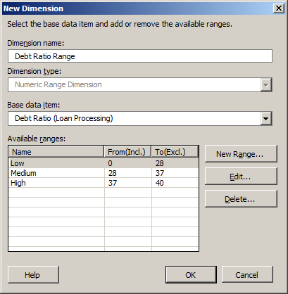
Enabling Business Activity Monitoring (Analyst)
Analyst defines:
Events and data to be tracked
Logical groupings and aggregations of tracked data views
Use BAM Activity Wizard to define:
Activities
Milestones
Data points
Views
Durations
Dimensions
Measures
Notes:
Overview
The creation and implementation of BAM to monitor business processes usually involves several different roles with different skill sets and tools.
Business Analyst Role
The role of the business analyst is to create BAM activity definitions (activities) and to create the views that will be available to end users to view the business processes. Generally, Business Analysts do not know, and do not need to know, what the actual orchestration that defines the business process looks like. They know what information is important to track and the order in which the process occurs.
Create Activity
Analysts use Microsoft Excel 2010 to create activities that identify in list form the key performance indicators (KPIs) of the business processes, for example, receiving and processing a purchase order (PO). These activities will include milestones (a date/time measure for the receipt of a PO or the sending of an invoice) in addition to data points of interest, such as the order date, PO number, total, and discounted total amounts. These data points might be of interest for tracking and auditing purposes.

Slide 94
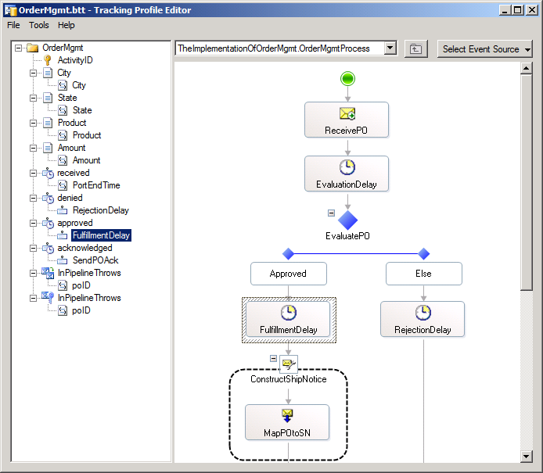
Enabling Business Activity Monitoring (Developer)
Tracking Profile:
Has characteristics that define a business-related process
Contains a mapping between an orchestration and activity definition
Use Tracking Profile Editor to:
Create and modify tracking profiles
Select orchestration shapes
Select schema elements
Link multiple activities together
Modify existing tracking profiles as long as the activity has not changed
Notes:
Tracking Profile Editor (TPE)
The Tracking Profile Editor (TPE) is a graphical user interface used by developers to create and modify the tracking profiles that map a specific view of internal business processes and associated data to a business process that might be represented by one or more orchestrations.
When you use the TPE to create a tracking profile, you create or load a profile that will define the relationship between:
One or more BizTalk assemblies that have been deployed to the BizTalk Configuration database; each assembly may contain one or more orchestrations, pipelines, schemas, and property schemas.
The activity, created by the business analyst, that has been deployed to the tracking database by the use of the BAM Management command-line tool.
If you have multiple BAM activities deployed, you can use the TPE to create links of continuations between the activities. Linking BAM activities brings together the business analyst’s view of the process with the real-world implementation of that process as a group of orchestrations.

Slide 95
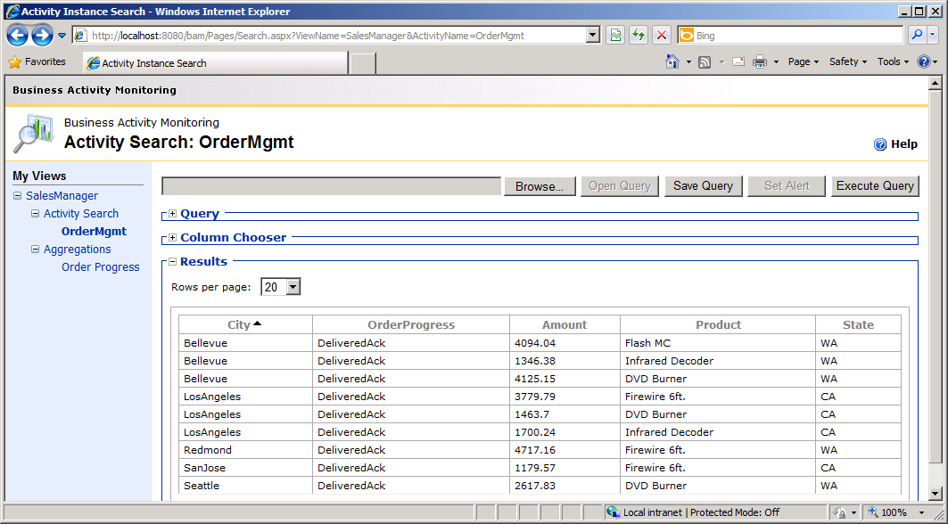
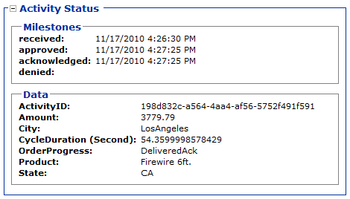
What Is the BAM Portal?
Notes:
The BAM Portal is a tool in BizTalk Server 2010 that is used to view data collected in the BAM databases from a business process. When the model is deployed by using the BAM Manager, the views included in the data collection model are rendered as views for the BAM Portal. The BAM Portal is a Microsoft ASP.NET application (it does not rely on Windows SharePoint Foundation). For companies that already have SharePoint sites, Web parts are available to simplify integration of BAM data into those sites.
The BAM Portal gives you the ability to:
Access pre-created views of the business data created by the business analyst and work with PivotTables® in real time. In this way, users can customize the view to their own preferences.
Perform activity searches against BAM data to find specific BAM activity. For example, the preceding slide shows sales manager data for the OrderMgmt application. Queries can be saved and reused. They can also be the basis for an alert, such as notification when a purchase order arrives from the specified customer.
Drill down to see detailed information. This example shows the activity status for the city of Los Angeles. The Activity Status view shows the dates on which several business milestones were reached and tracking information (the Activity ID), in addition to the other data. With this functionality, it is easy to start with aggregated data (all orders processed) and see the details for orders that make up the totals.
Configure and share alerts to notify specific users in the event that particular threshold conditions are met—for example, if the number of unprocessed purchase orders exceeds 100, send an e-mail message to the sales manager. Once created, alerts can be subscribed to by other users who are interested in the same information.
Escalate issues to the systems administrator. A link is provided to send feedback to a preconfigured e-mail address notifying the recipient of problems that are identified by portal users.

Slide 96
Introduction to Message Routing

Slide 97


The Publish and Subscribe Architecture
XML or Flat File
Business Process
A filter expression defines properties of messages in which each subscriber is interested.
1
Messages received, processed, and published to the MessageBox database
Receive Location
2
Receive Adapter
XML
Subscribed
Message Database
Receive Pipeline
A copy of the message is delivered to each subscriber
4
Message properties are evaluated to determine which subscribers require a copy of the message
3
Subscribed
Send Port
Notes:
The Publish and Subscribe Architecture
BizTalk Server uses a publish and subscribe (or pub/sub) messaging model. The pub/sub model is highly scalable at both the database and processing levels. This pub/sub routing mechanism can manage large volumes of messages and large individual messages, and can interact with a wide variety of back-end systems. This design also makes adding and changing subscribing components on-the-fly extremely easy.
Publication
Publication is the process by which messages are placed in the MessageBox database. The principal publishing component in BizTalk Server is the receive port, which receives and processes messages into the database. Orchestrations also publish messages as they are sent from the orchestration to the MessageBox database for further routing.
Subscriptions
Subscriptions are criteria on which message routing is determined. Orchestrations, send ports, and send port groups can each subscribe to messages. Each subscription allows the subscriber to initiate or continue the processing of a message. Subscriptions are managed by the MessageBox database.
When a message meets the specifications of a subscription, the message is passed from the MessageBox database to the subscriber. If multiple subscribers exist for a given message, each gets a copy of the message.

Slide 98


What Is the MessageBox Database?
MessageBox Database
Stores subscription information
Delivers messages to subscribers
Stores the queues and state tables for each BizTalk host
Stores messages and message properties
Administration Tasks
Adding a new MessageBox database
Disabling new message publication
Deleting a MessageBox from a BizTalk group
Notes:
The MessageBox database stores messages and message properties, and it maintains message subscriptions. The messaging engine delivers the messages from the database to subscribers. The MessageBox databases also store the queues and state tables for each BizTalk host.
Messages are immutable once they arrive at the MessageBox database, but beforehand, messages can be manipulated in a variety of ways, including validating the message against a known schema, promoting specific nodes to be used in message routing, decrypting a message, or transforming a message by using a BizTalk map. Each of these processes is addressed in other modules in this course.
Adding MessageBox Databases
MessageBox databases are the basis of work-item load balancing across multiple servers that perform cooperative processing. With all of the messages and processes that the MessageBox database is responsible for, it can rapidly become a bottleneck in a BizTalk environment. To increase the number of messages that your system can process, you may need to create additional MessageBox databases. With the Enterprise edition of BizTalk Server 2010, you can use the BizTalk Administration Console to create multiple MessageBox databases.
When multiple MessageBox databases are in use within a BizTalk Server Group, the master MessageBox (the first one created) acts only as a router and routes all new messages to the other message boxes for processing. A degradation of performance can occur when there are only two MessageBox databases because the messages are still being processed by only one database since the master database performs only the routing of messages. Therefore, it is highly recommended that when using multiple MessageBox databases you have at least three MessageBox databases.

Slide 99


What Is Message Routing?
Receive Location
Receive Adapter
Send Port A
Send Port B
PO Message
Receive Pipeline
Send Port C
MessageBox Database
Message Routing
Filter Expression | Port
If CustomerName = Contoso | A
If Price > 1000 | B
If Qty > 500 and Price < 1000 | C
Routes directly to a port
Based on a filter expression
Configured on the send port
Notes:
Message Routing
A typical BizTalk Server business process involves receiving, processing, and sending messages. At times, you may receive messages (such as partner-to-partner correspondence) that do not require intensive processing in an orchestration, and that could therefore benefit from a simpler solution. The BizTalk content-based message routing model provides great flexibility in the way that messages are handled. For example, two incoming messages of the same type can be processed differently based on a customer name or a total order amount.

Slide 100
What Is a Port?
Ports specify:
How messages are sent and received by BizTalk
The communication direction and communication pattern
The location where messages are received or sent
Receive Port
Send Port
Receive Location
Maps
Maps
Receive Location
Receive Location
MessageBox Database
Notes:
Ports
Ports specify how messages are sent and received inside BizTalk Server, as well as between BizTalk Server and external processes. Each port has a direction, a transport type, and a binding, which together determine the direction of communication (one-way or two-way), the pattern of communication (one-way or request-response), the location to or from which the message is sent or received, and how the communication takes place. A port’s binding may refer to the physical location of a read or write, the pipeline used for message processing, or an orchestration.
A port must be associated with:
A Universal Resource Identifier (URI—a physical location).
A transport (examples are File, HTTP, and BizTalk Message Queuing).
A port may be associated with:
A send pipeline, to prepare a message for sending. For example, pipelines can be used for assembling, encrypting, compressing, or performing some other action on a message.
A receive pipeline, to prepare a received message for processing. For example, receive pipelines can be used for disassembling, decrypting, or decompressing a message.
A map, to transform messages from one type to another.

Slide 101
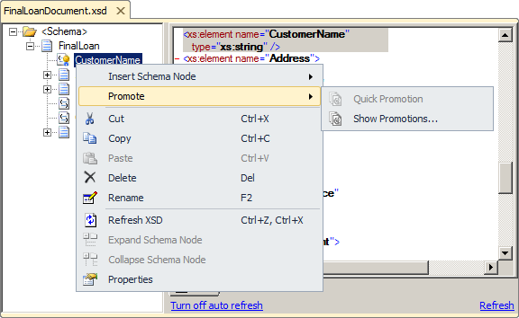
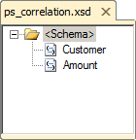
What Is Property Promotion?
Property promotion
Fields that you choose to promote within a message instance
Makes the data in the field accessible to BizTalk services
Quick promotion automatically creates a property schema
Notes:
In BizTalk Server, promoted properties enable various BizTalk components to access key items of data contained in a message. Promoting a property makes the data within that node of the schema accessible to messaging processes.
Performing a quick promotion on a schema node promotes the node to the default property schema defined for the XML schema in question. If a property is quick promoted and no default schema yet exists, Microsoft Visual Studio® will offer to automatically create the schema for you. Quick promotion is done by right-clicking the node and then clicking Quick Promote.
Promoted Properties
Property promotion enables BizTalk messaging services to route messages based on the context and content of the message. You want to promote properties only when required for message routing, message correlation (a special form of message routing, which will be covered in Module 9, “Automating Business Processes”), or property-tracking. Excessive property promotion can adversely affect BizTalk Server performance.

Slide 102
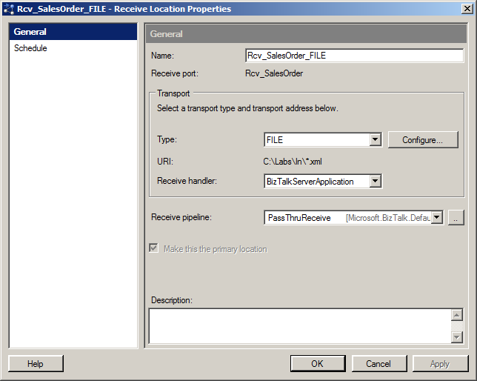
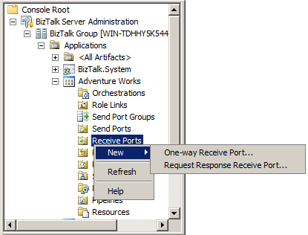
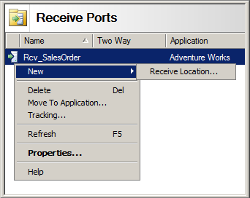
Configuring a Receive Port and Receive Location
Receive location properties:
Receive handler (host)
Enabled or disabled
Start/stop receiving (date)
Operating window (time period)
Notes:
Receive Ports
BizTalk Server uses receive ports to receive messages from internal systems and trading partners. Receive ports can be configured to use one or more maps for incoming message transformation. If more than one map is specified, only the map that matches the inbound message will be applied. You can also configure the port to track message bodies or properties. Although message body tracking provides more information about each message, it can adversely affect the performance of BizTalk Server.
Additionally, receive ports can function as either one-way ports or two-way ports.
Receive Locations
A receive port can have multiple receive locations associated with it. This is useful when you have messages being received from multiple physical locations, such as from a file folder and an FTP site, but you want all the messages received through any of the locations to be processed in the same manner.
Receive locations are configured with a URI, an address from which inbound messages arrive, a receive handler, and a receive pipeline. The URI is specific to the transport or adapter type (FILE, FTP, HTTP, Microsoft SharePoint® Services, and others).
Receive locations can be in one of three possible states:
Enabled. When enabled, receive locations process messages.
Disabled. Disable a receive location if you want to prevent the receive location from receiving messages or if you want to delete the receive location.
Suspended. If a service window has been configured for the receive location, the location will indicate that it is suspended while the service window is inactive.

Slide 103
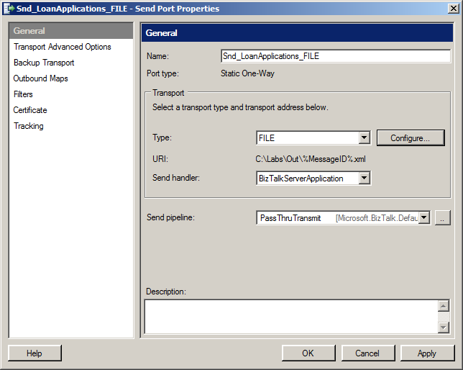
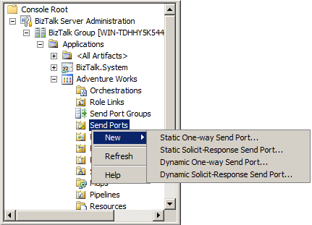
Creating and Configuring a Send Port
Send port properties:
Send port name
Primary and secondary transport
Address (URI)
Retry count
Service window enabled/disabled
Notes:
Send ports are the locations to which BizTalk Server sends messages. A send port can function as either a one-way port or a two-way port. As specified earlier, one-way ports send messages, and two-way ports (also known as solicit-response ports) can both receive and send messages. However, not all adapters support two-way ports. The FILE, MSMQT, and SMTP adapters are supported only as one-way ports.
There are three general types of send ports:
Static send ports. These send ports contain a fixed destination address. When you create a static send port, as in the preceding illustration, you specify the adapter type, destination address (URI), and pipeline used for the static send port.
Dynamic send ports. Dynamic send ports do not contain a fixed destination address. Instead, the destination address is set within the orchestration.
Direct send ports. In the case of the static and dynamic send ports, the message is written to the MessageBox database before being processed into the send port. In some situations, it may be advantageous to have orchestrations communicate directly. In these cases, direct send ports can be used.
Send ports can be created using either BizTalk Explorer or the BizTalk Administration Console. Some of the properties you can configure for a send port include:
Send port name. Since you will likely have many send ports in your application, you should always assign a descriptive name to a send port to help identify which messages or processes are associated with a specific send port. For example, POAck_to_Vendor is a much better name then Port_1. Also, descriptive names can help when moving from one environment to another.
Primary and secondary transport. Examples of transport types include FILE, FTP, SQL Server, and HTTP. Send ports contain both a primary and a secondary transport type so that if the primary transport is unavailable for some reason, messages can still be sent using the secondary transport type. For example, your primary transport type may be an FTP site. However, if the FTP site is unavailable, you can set the secondary transport to FILE and still successfully process messages through the send port. Later when the FTP site is back online, you can manually transfer received messages from the file location to the FTP site.
Address (URI). The address or URI is the physical location where messages are sent when processed by a send port. The address is dependent upon the transport type.
Retry count. The retry count is the number of times BizTalk will try to resend a message if the transmission fails. The default value is 3, which is satisfactory for many situations, but the allowed range is 0 through 1000, which allows flexibility in use. For example, you may not want retries to occur at all when communicating with a Web service, whereas you may want to try continuously until successful when sending to a SQL database.
Service window enabled/disabled. You can enable the service window if you want to configure a port to send only at specified times of the day. By default, the service window is disabled, meaning that the send port will send messages at any time. If the service window is enabled, the Start Time and Stop Time properties must be specified. You can enable the service window, for example, if you want to send messages to a busy HTTP site only between midnight and 08:00 to prevent network delays during normal business hours. The messages will actually be delivered to the send port and be queued in the spool table in the MessageBox database until the appropriate time.

Slide 104
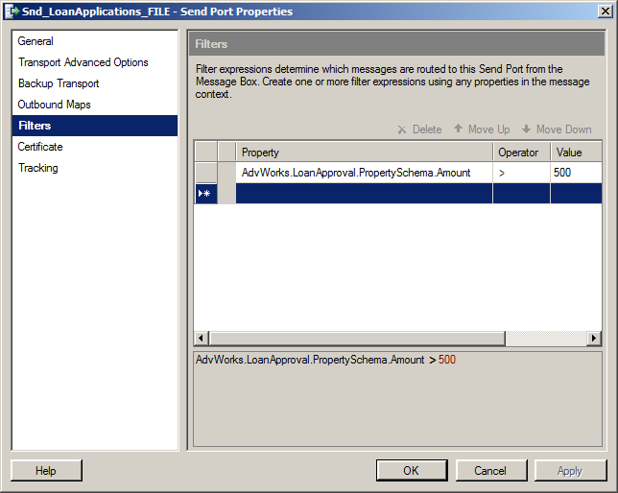
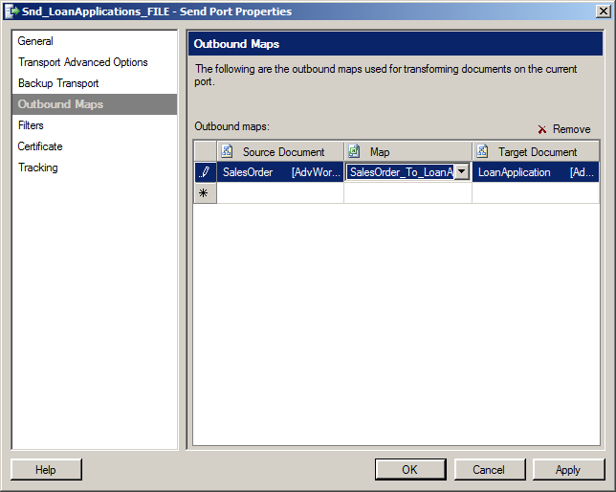
Configuring Send Port Filters
1
Create filter expression
Filtering
Filter messages based on an expression
Route to a send port
Example: If the Amount is greater than or equal to $500, forward the message to a folder for approval
Use to subscribe to failed messages
Notes:
Filter Expressions
Filter expressions are used to create subscriptions. Subscriptions determine which messages will be delivered to a specific port. You can use both the promoted properties from the inbound message schema and the BizTalk global properties to create the filter expressions on a send port. This is known as content-based routing because the actual contents of the message are used to determine how the message should be routed. For example, if you need to route all messages with an order amount over $500 to a specific folder for managerial approval, you can promote the amount node in the source schema and then create a filter expression for a send port to subscribe to messages only with an amount greater than or equal to $500.
Subscribing to Failed Messages
BizTalk Server 2010 provides the ability to create a subscription for failed messages. When failed message routing is enabled on a receive port, a filter expression on a send port can be used to send the failed message to an orchestration or some other endpoint, such as a SharePoint site, to fix the error and resubmit the message. A sample of an error handling solution is provided in the BizTalk Server 2010 SDK (software development kit).

Slide 105
BizTalk Demos

Slide 106
Job Market
job opportunities

Slide 107


BizTalk Jobs Profiles
BizTalk Architect
BizTalk Developer
BizTalk Administrator
A system administrator will have other concerns such as the health of servers and their activity (HAT - Health and Activity Tracking), he has overall responsibility for the BizTalk Environment, such as: installation, configuration and system maintenance, deploying and managing BizTalk Applications, monitoring (unlocking messages and processes or ensuring proper flow of messages), disaster recovery.
Knower of the entire system integration: backup and recovery plans, security, logging, message flow, communication interface… Using his knowledge as well as a programmer, the architect should know the capabilities and limitations of the tools at his disposal (BizTalk engine, BAM, BRE) and design projects making the best choices for each situation.
Implements and extends the basic functionalities, taking advantage of the different tools. Here there are many areas completely orthogonal and a programmer may not master them all at the same level: Orchestration, Adapters, Pipelines, Mappings, Functoids, Routing, Rules, Tracking, OLAP, and many more.
Notes:
Information Workers/Business Analysts
The role of a business analyst is to define the rules and actions that make up a business process and to define the key performance indicators used to monitor business activity.
Developers
Developers use the design provided by the business analyst to create an application that models the business process.
IT Professionals/Administrators
The administrator plays an important role by establishing a secure BizTalk environment, setting up communications among the parts, deploying the application, and performing other administrative tasks to manage the BizTalk environment and applications in a production environment. The administrator role also includes the installation and configuration of a stable and high-performance SQL server environment.

Slide 108
Job opportunities
BizTalk Developers needed in: Miami, NYC, Jacksonville, Austin, Sacramento, Louisville, Hawaii, Panama City, Montevideo, London, Toronto, Preston, Porto.
BizTalk Administrator needed in Ft. Lauderdale FL 75K - 100K depending on experience.
BizTalk Developer/Architect needed for International Law Firm in NY. 110k-130k.
6 Month BizTalk 2009 Consultant required for Public Sector project in London. Rates negotiable but c£500-£550 per day.
2 BizTalk Developer Needed in NYC - Healthcare, mid-level $95-110K and senior level $105-120K.

Slide 109
What’s Next?
Future and evolution

Slide 110




BizTalk Server 2013
Key Themes
Platform Support
Stay up-to-date with the latest platform.
Improved B2B
Industry standards support, performance improvements.
Ready for the Cloud
Start enjoying the benefits of the cloud.

Slide 111
BizTalk Server 2013
Platform Support
New Platforms and Infrastructure
Windows Server 8
SQL Server 2012 (“Denali”)
Continued support for Windows Server 2008 R2, SQL Server 2008 R2
Increased Developer and IT Productivity
Visual Studio 11 and Windows 8 to develop solutions
In-place migration from BizTalk Server 2010
Extended Platform Integration
DB2 client connectivity to SQL Server, conversion of commands to T-SQL, migration of packages to stored procedures
Adapter connectivity to new data sources, including IBM Informix V11 and IBM IMS/DB V11
Improved B2B
Agile Response to Industry Standards
Regular updates to schemas, accelerators certifications and adapters. Highlights include:
Healthcare: HIPPA 5010 extensions: 2777CA, 999, HL7 2.5.1
Finance: SWIFT SRG 2011 support, SWIFT SRG 2012, SWIFTNet 7.0 (new messaging platform)
Improved Performance and Scalability
HL7 MLLP adapter performance improvements
Better performance with ordered send ports
Enhanced scale out configuration with multiple hosts
Expanded adapter options for faster batch processing
Ready for the Cloud
BizTalk Server on Windows Azure
Enable running BizTalk Server on a Windows Azure virtual machine
Enjoy the benefits of IaaS scale and elasticity
Leverage Windows Azure services, such as Service Bus
Extend on-premises solution to the cloud
Easily extend your on-premises BizTalk Server solution to the cloud in a secure manner
Tighter integration of on-premises BizTalk Server applications with Windows Azure Service Bus
Improved Licensing
Adjustments to licensing that are geared towards cloud hosting, including:
Purchase from a hoster on a monthly basis (SPLA)
Register your existing license with a hoster (License Mobility)

Slide 112
Timeline
5/2011 Cumulative Updates
11/2010 BizTalk Server 2010
+6 months
BizTalk Server 2013
Windows Server 8

Slide 113
Questions?

Slide 114


Next Events…
3th December 2012
Introduction to the Azure Service Bus EAIEDI features
At Universidade Portucalense
16th January 2013
BizTalk Innovation Day – London
Great speakers including 4 Microsoft Integration MVP's
at Microsoft UK
March 2013
DevScope BizTalk Innovation Event – Porto!!!

Slide 115
Blog: http://sandroaspbiztalkblog.wordpress.com
MVP Profile: https://mvp.support.microsoft.com/profile/Sandro.Pereira
MSDN Profile: http://social.msdn.microsoft.com/profile/sandro%20pereira/
Member of BiztalkAdminsBlogging: http://www.biztalkadminsblogging.com/
Member of BizTalk Brazil Community: http://www.biztalkbrasil.com.br/
Twitter: http://Twitter.com/sandro_asp
LinkedIn: http://pt.linkedin.com/in/sandropereira
Thanks
Sandro Pereira
Rua Passos Manuel Nº 223
4º Andar
4000-385 Porto
sandro.pereira@devscope.net
+351 223 751 350
www.devscope.net
© 2012 DevScope. All rights reserved. DevScope, SmartDocumentor, myWebDrive and other product names are or may be registered trademarks and/or trademarks in the U.S. and/or other countries. The information herein is for informational purposes only and represents the current view of DevScope as of the date of this presentation. Because DevScope must respond to changing market conditions, it should not be interpreted to be a commitment on the part of DevScope, and DevScope cannot guarantee the accuracy of any information provided after the date of this presentation. DEVSCOPE MAKES NO WARRANTIES, EXPRESS, IMPLIED OR STATUTORY, AS TO THE INFORMATION IN THIS PRESENTATION.

